Slide 1
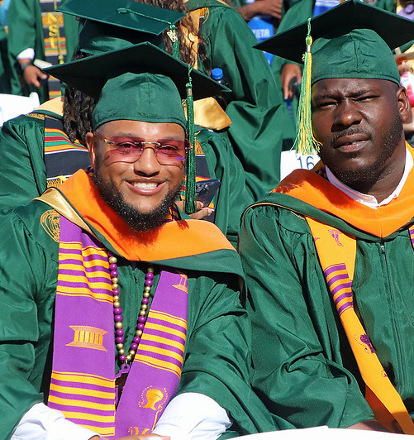

Commencement
MAY 2026 Information Booklet
Norfolk State University
700 Park Avenue | Norfolk, VA 23504
757-823-8600 www.nsu.edu

Slide 2
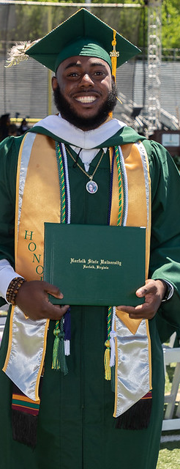
AGENDA
Task | Location | Deadline
Deadline to apply for May 2026 Graduation | Academic Department | Friday, February 6 Last day to submit a May 2026 Graduation Application
Purchase Academic Attire | NSU Bookstore www.norfolkstate.bncollege.com or http://colleges.herffjones.com/college/Norfolk | Monday, February 23 (online purchase and items shipped to NSU bookstore) Tuesday, April 14 (online purchase and items shipped to graduate’s home) Friday, April 24 (Late Ordering) (online purchase and items shipped to graduate’s home) Friday, May 8 (in store purchase)
Graduation Fair | NSU Bookstore www.norfolkstate.bncollege.com | Monday, March 30 and Tuesday, March 31 11 a.m. – 3 p.m.
Pay $30 Graduate Application Fee | Cashier’s Office, Student Services Center, 2nd floor, Room 209 | Wednesday, April 29
Direct Loans Exit Counseling Please call 757-823-8381 | Financial Aid, Student Services Cener 2nd Floor, Suite 209 | At least 2 weeks before graduation
Perkins Loans & VA State Loan Exit Counseling Please call 757-823-8381 | Financial Aid, Student Services Cener 2nd Floor, Suite 209 | At least 2 weeks before graduation
Confirm all tuition and fees have been paid | Cashier’s Office, Student Services Center, 2nd floor, Room 209 | Must be done to receive degree & transcripts
Pay any outstanding parking tickets | University Police Department | Must be done to receive degree & transcripts
Pay any outstanding library fines | Lyman B. Brooks Library Circulation/Reserve Department, 1st floor | Must be done to receive degree & transcripts
Attend the Senior Toast | Spartan Greens Call the Office of Alumni Relations for more details. 757-823-8135 | Thursday, May 7 6 p.m.
Pickup Tickets & Graduation Announcements | Joseph G. Echols Memorial Hall | Friday, May 8 9 a.m.
Attend Commencement Rehearsal | Joseph G. Echols Memorials Hall Please bring your academic hood and picture ID to the rehearsal | Friday, May 8 9 a.m.
Commencement Day! | William "Dick" Price Stadium Please bring your picture ID 7:00 a.m. Name Cards Distributed 9:00 a.m. The Commencement ceremony begins with academic processional | Saturday, May 9 9 a.m.
Notes:
Need to update deadline dates?

Slide 3
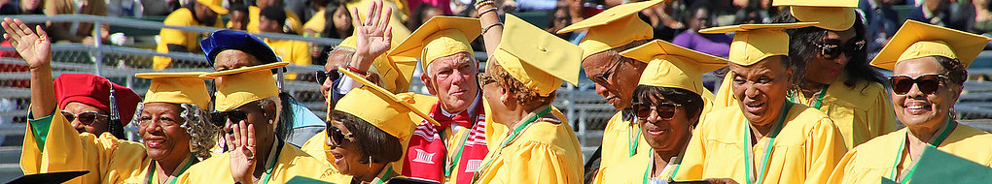
COMMENCEMENT INFORMATION

Slide 4
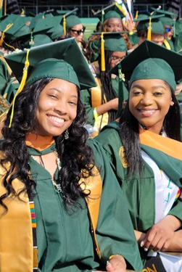
Commencement Day Information
Norfolk State University’s Spring 2026 Commencement will be held on campus at William "Dick" Price Stadium on Saturday, May 9, 2026. The processional will begin at 9:00 a.m. with the program immediately following.
Graduates Check-In
Graduates may begin arriving at the Price Stadium Ticket Window at 7:00 a.m. to pick up name cards. However, all graduates must be checked-in no later than 8:00 a.m. Graduates will be directed to the designated area(s) for student line-up in the Woods Science Building. Graduates arriving after 8:00 a.m. will not be allowed to join the academic processional.
*Please allow extra time as all individuals participating in commencement will use the same entry and security check points.
Regalia & Attire
Full academic regalia (cap, gown, tassel, and hood) is required for those participating in the academic processional. Graduates should refrain from bringing personal items (i.e. purses, bags, cell phones and other electronic devices). Please also plan to wear appropriate, professional attire and comfortable shoes. (No Athletic Gear).
Professional Attire: suit, button down shirt, tie, skirts and/or slacks, dress shoes; dark colors to match green robes; modest heel height strongly recommended.

Slide 5
Degrees and Certificates
Presentation of Candidates – The Dean of each of the University’s schools/colleges will present to the President the candidates for graduation from the school/college by department. As the department is called, the candidates from the department will stand.
Hooding – Only doctoral degree candidates will be hooded during the commencement ceremony. All other candidates should arrive at commencement ceremony in full academic regalia (cap, gown, hood, and tassel.) *Candidates should bring academic hoods to the Commencement Rehearsal.
Conferring of Degrees – After the President has conferred the degrees, those graduates will begin their walk to the stage to receive their degree. (Spacing will be supervised by designated marshals). Upon proceeding to the stage, graduates will receive their degree from the University Registrar and pass the name card to the Reader. Once the student’s name is called, graduates will proceed to the President for handshake and picture. Upon returning to their seats, graduates will remain standing until the last person in the row has returned, whereupon all in the row may be seated. When the ceremony has concluded, graduates will follow designated marshals back to the assembly area.
Names in Commencement Program Booklet - The names of candidates appearing in the Commencement Program Book will be of those who had a graduation application submitted to the Office of the Registrar prior to the close of business Monday, April 20th. Any graduation candidate applications received after this date will not be listed in the commencement program. Having your name in the commencement program does not mean your degree will be conferred.
Ceremony Expectations
All graduates are expected to remain until the end of the program and process out of Price Stadium in an orderly manner. Graduates must remain in assigned seats to ensure that the correct degree is received. Graduates and all guests are expected to celebrate respectfully and exhibit respectful behavior at all times.
Tickets & Graduation Announcements
Commencement will be held on the campus at William "Dick" Price Stadium. Tickets are not required to enter the Stadium.
Tickets are only necessary in the event of inclement weather and the ceremony being moved into Echols Hall. Each graduate will receive six (6) rain tickets for the May 9 commencement ceremony in the event of inclement weather. All guests from ages two (2) and over must have a ticket to enter Echols Hall.
Graduates are responsible for disseminating ceremony rain tickets to their guests. Graduates do not need a ticket for the ceremony. No extra tickets will be available for the ceremony. Seating is first come, first served.
Ticket Pick Up
Graduates may pick up rain tickets at the commencement rehearsal on Friday, May 8th. Picture ID is required in order to retrieve tickets. Tickets are only necessary in the event of inclement weather and the ceremony being moved into Echols Hall.
Notes:
Need to remove rain tickets as we are inside already? Update Commencement Program Booklet deadline?

Slide 6
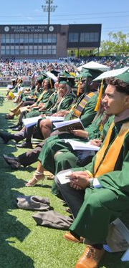
Venue Information & Parking
Norfolk State University’s Commencement will be held on campus at William "Dick" Price Stadium. Stadium gates will open to the general public at 7:00 a.m. Parking will be available throughout the campus.
All parking lots will be open and available for guests except for Lot 8 at Echols Hall.
Limited handicapped parking will be available to guests on a first come, first serve basis. Lots 9, 11 & 12 have been designated as handicapped lots for the commencement ceremony. Once these lots reach capacity, guests will be directed to other lots for parking. To gain access to the designated handicapped parking lots, enter the NSU Campus via Gate 8 (located off Ballentine Ave and/or MiddleTowne Arch).
Shuttle services will be available to transport guests to/from parking lots to William "Dick" Price Stadium. Guests will have to walk to the nearest shuttle stop for pick-up. Shuttles services will begin at 7:00 a.m.
(Please take notice of the lot you park in as shuttles service all lots)
Notes:
Make sure parking is still the same?

Slide 7
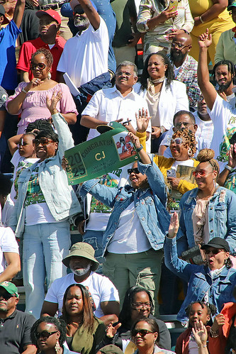
Information for GUESTS attending the Commencement Day Ceremony

Slide 8
Ceremony Venue
The 116th Commencement Ceremony will be held at William "Dick" Price Stadium. Stadium gates will open to the general public at 7:00 a.m. No tickets are required for entry into the Stadium. Tickets are only required if the ceremony is moved inside due to inclement weather. All guests ages 2 and older must have a ticket to enter Echols Hall.
Tickets
Each graduate will receive six (6) rain tickets for the ceremony. All guests from ages 2 and over must have a ticket to enter Echols Hall. No extra tickets will be available. Graduates do not need a ticket for the ceremony.
*NOTE: If the ceremony remains in the Stadium, tickets will not be needed.
Guest Seating
Seating is available on a first come, first served basis. No saving of seats is permitted. All guests will be required to sit in the bleachers of the Stadium. Only graduates, faculty, and working commencement staff are allowed on the field. Handicapped seating will be available in the designated areas around the stadium.
Masks
Face masks are not required for anyone attending the commencement ceremony. However, guests may choose to continue to wear masks at their own discretion. Please respect the masking decisions of all patrons.
Safety and Security
For the safety and security of all participants and attendees will be required to enter through security check points. Guests will be subject to metal detectors and/or wanding upon entry into the stadium. For a safe and smooth entry into the graduation area, it is recommended to use clear see-through bags and small clutch bags that are approximately the size of your hand. No weapons of any kind are permitted on campus. The following items are prohibited and should not be brought to campus: noise makers, confetti, balloons, inflatables, wrapped packages, placards/signs, backpacks, firearms, weapons including fireworks, firearms, sticks, clubs, knives of any length, and other weapons.
*Please do not bring any prohibited items.
Bag Policy
NSU strongly encourages guests to not bring any type of bags. However, guest can bring the following style and size bag, package, or container:
Bags that are clear plastic, vinyl or PVC and do not exceed 12” x 6” x 12.” No buckles, grommets/hardware or decor can conceal any part of the bag. The bag must be all clear.
One-gallon clear plastic freezer bag (Ziploc bag or similar).
Small clutch bags, approximately the size of a hand, with or without a handle or strap can be taken into the arena with one of the clear plastic bag options.
*Please note that all bags are subject to search by NSU Police.
Alternate Ceremony Viewing Options
On campus viewing option: L. Douglas Wilder Performing Arts Center. Doors open at 7:30 a.m. No tickets are needed for the Wilder Center.
*Off campus viewing option: Guests may view the ceremony at www.nsu.edu.
- streaming begins at the start of the ceremony
Parking
Norfolk State University makes every effort to accommodate guests with mobility challenges. We want our patrons to have a positive memorable on-campus experience. Parking attendants will be on hand to provide assistance and guidance.
All parking lots will be open and available for guests except for Lot 8 at Echols Hall.
Limited handicapped parking will be available to guests on a first come, first serve basis.
Parking will not be available at Price Stadium.
Lots 9, 11 & 12 have been designated as handicapped lots for the commencement ceremony. Once these lots reach capacity, guests will be directed to other lots for parking. To gain access to the designated handicapped parking lots, enter the NSU Campus via Gate 8 (located off the Ballentine Ave and/or MiddleTowne Arch).
Shuttle services will be available to transport guests to/from parking lots to Echols Hall. Guests will have to walk to the nearest shuttle stop for pick-up. Shuttles services will begin at 7:00 a.m.
* Please take notice of the lot you park in as shuttles service all lots.

Slide 9
NOTE: Please be advised that it is a lot of walking; therefore, it is recommended that guests with mobility challenges use walking assistive devices such as wheelchairs, scooters, etc. to and from Price Stadium.
Photography by Guests
It is permissible for Commencement guests to photograph proceedings from the stands only. No one other than those who have been issued a “Press Pass” will be allowed to take pictures on the field.
Inclement Weather
In case of severe weather that would alter the location of the ceremony, schedule time, and/or cancellation of the ceremony, please visit the NSU website at www.nsu.edu, call the University operator at (757) 823-8600, listen to WNSB 91.1 FM, or tune in to WNSU Channel 47.
All guests will be required to have a ticket in order to gain access to the inclement weather location. Each graduate will be given six (6) rain tickets at the commencement rehearsal. Distribution of commencement rain tickets is solely the responsibility of the graduate. Extra tickets will not be available.
In the event of inclement weather, decisions about the ceremony will be made no later than 6:00 a.m. Commencement day.

Slide 10
Hotel Information
Hotels closest proximity to campus
Less than 2 miles
Courtyard Norfolk Downtown 520 Plume Street Norfolk, VA 23510 757-963-6000 | Norfolk Waterside Marriott 235 E Main Street Norfolk, VA 23510 757-627-4200 | Sheraton Norfolk Waterside 777 Waterside Drive Norfolk, VA 23510 757-622-6664
Hilton Norfolk The Main 100 East Main Street Norfolk VA 23510 757-763-6200 | Wyndham Garden Downtown 700 Monticello Ave Norfolk, VA 23510 757-986-9573
Less than 5 miles
CandleWood Suites Norfolk Airport 5600 Lowery Road Norfolk, VA 23502 757-605-4001 or 888-226-3539 | Double Tree by Hilton Hotel 1500 N. Military Hwy Norfolk, VA 23502 757-466-8000
Less than 10 miles
Aloft Chesapeake 1454 Crossways Blvd Chesapeake, VA 23320 757-410-9562 | Crowne Plaza Virginia Beach Town Center 4453 Bonney Road Virginia Beach, VA 23462 877-270-1393 | Holiday Inn Virginia Beach-Norfolk Hotel and Conference Center 5655 Greenwich Road Virginia Beach, VA 23462 757-499-4400
Norfolk Marriott Chesapeake 725 Woodlake Drive Chesapeake, VA 23320 757-523-1500
Many establishments may provide a discounted rate for visitors attending NSU commencement. Be sure to inquire with the reservation agent.
To assist family and friends with their accommodation needs, the following list of hotels has been provided:

Slide 11
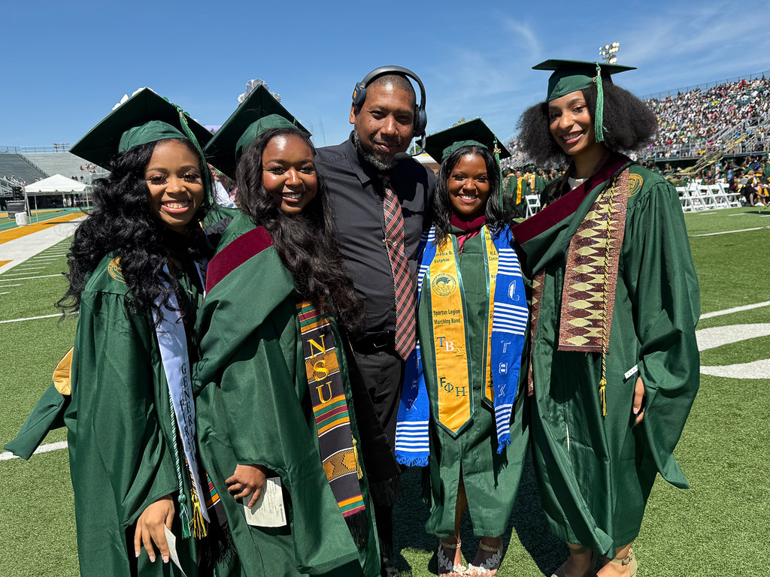
PreparinG foR the Ceremony

Slide 12
Participation in the Commencement Ceremony
Only those students who have been conferred will be allowed to participate in commencement. Degrees will be distributed during the commencement ceremony to students with no outstanding financial obligations. If you are taking a course(s) at another institution during your last semester, this can adversely affect your graduation participation as all grades MUST be posted in order for your degree to be conferred. Any candidate who submits a graduation application and has it processed by the Office of the Registrar will be able to purchase graduation attire when it is made available by the NSU Bookstore (distribution information will be posted by NSU Bookstore). This does not mean that you will be allowed to participate in the commencement ceremony.
Commencement Fees
All degree candidates are required to pay the mandatory $30 graduation application fee. The payment deadline is Wednesday, April 29th. (The application fee is assessed each time an application is submitted.) Students must be financially cleared in order to receive degree and/or transcripts. This includes payment of the graduation fee, tuition and all other fees (Cashier’s Office, Student Services Center, 2nd floor, Room 209) as well as any outstanding parking (University Police Department) or library fines (Lyman B. Brooks Library Circulation/Reserve Department, 1st floor).
Important Dates to Remember:
Wednesday, April 29th - Final grades are due to the Office of the Registrar for Spring 2026 graduation candidates.
The Office of the Registrar will send an email to all undergraduate and graduate candidates informing them of their degree conferral and eligibility to participate in commencement ceremony. All questions should be directed to the Office of the Registrar at 757-823-8377 or regstrar@nsu.edu.
Commencement Rehearsal
Norfolk State University’s Commencement Rehearsal will be held at 9:00 a.m. on Friday, May 8, 2026 in Joseph G. Echols Memorial Hall. It is mandatory that all candidates for graduation attend Commencement Rehearsal. The rehearsal will last approximately two hours. Graduates will receive the most up-to-date information regarding commencement check-in, graduate line-up, and other pertinent details. Graduates should bring picture ID and their hood.
Senior Class Toast
The Senior Class Toast will be held at 6:00 p.m. on Thursday, May 7 on the Spartan Greens. Ticket pick up and all other information regarding the Senior Class Toast will be disseminated by the Office of Alumni Relations. For more information, please call 757-823-8135.
Academic Attire
Full academic regalia (cap, gown, tassel, and hood) is required for those participating in the academic processional. Students will not be able to participate in Commencement Exercises without securing academic attire. It is strongly recommended that you purchase attire through the NSU Bookstore, as it has specific attire pertinent to NSU graduates.
In preparation for Commencement, the NSU Bookstore is requesting that you take the time now to review and prepare to order all of your graduation items. Academic regalia will be available for purchase up until the day before the commencement ceremony, while supplies last. Supplies are on a first come first-serve basis. In order to purchase regalia, your name must be on the current cleared graduation list provided by the Registrar’s Office.
Refunds and exchanges will not be accepted for academic regalia after the commencement ceremony. Honor stoles are worn by graduates receiving associate and bachelor’s degrees ONLY. Graduates’ names must appear on the honors list provided by the Registrar’s Office prior to purchase. Please note: Master’s degree candidates and Ph.D. candidates do not receive honor designations. Therefore, honor stoles are not worn for graduate degree candidates.
Online orders will begin on the first day of Grad Fair.
Online Orders will be shipped directly to the address provided
$15.99 Shipping and Handling Fee for online purchases
NOTE: ** Full payment for academic regalia is required when the order is placed. If writing a check, please make it payable to the NSU Bookstore. Please bring proper ID. The graduation fee does not cover your academic regalia.

Slide 13
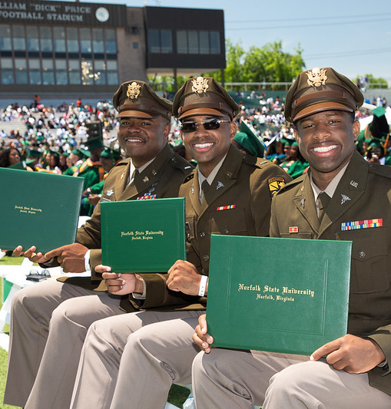
Graduation Fair
The NSU Bookstore will host the Graduation Fair in conjunction with Herff Jones from 11 a.m. – 3 p.m. on Monday, March 30 and Tuesday, March 31. For more information regarding the Graduation Fair, please call the NSU Bookstore at 757-823-2037 or visit www.norfolkstate.bncollege.com.
Loan Exit Counseling
Borrowers of the Ford Direct Student Loan, Federal Perkins Loan, and Virginia State Student Loan (VSSL) must attend MANDATORY EXIT COUNSELING SESSIONS. For Direct Loans Exit Counseling only please complete the exit loan counseling online before attending the in-person session by visiting www.studentloans.gov login in with your FSA ID. Please print proof of counseling completion at the end of the online session and bring copy to the in-person session. If you do not sign in with your FSA ID, you cannot meet the requirement for completing this counseling. For Federal Perkins Loan and Virginia State Student Loan (VSSL) Counseling, please complete the exit loan counseling online before attending the in-person session by visiting www.ecsi.net/myacct. Login with ECSIWebPin.
Please print proof of counseling completion at the end of the online session, and bring copy to the in-person session, assist with the completion of the online Exit Counseling information, please bring with you the names, addresses and telephone Numbers of three different references not living with you.
Please contact the Office of Financial Aid at (757) 823-8381 or financialaid@nsu.edu for all Ford Direct Student Loans and Mr. Raymond Johnson at (757) 823-2647 rajohnson@nsu.edu in the Office of Student Accounts for Virginia State Student Loans – VSSL and/or Federal Perkins Loans.

Slide 14
Direct Loan Late-Stage Delinquency Program
Norfolk State University is a participant in the William D. Ford Direct Loan Late-Stage Delinquency Program. Many students go into default on their student loans because they do not understand their repayment options. The Direct Loan Servicing Center is facilitating communications with delinquent borrowers to help schools reduce default rates. Defaulting on your student loan not only affects you, but it also adversely affects Norfolk State University where you obtained your student loan. Late-Stage Delinquency includes borrowers who are more than 240 days, but less than 361 days, delinquent in making a payment on a subsidized or unsubsidized student loan. Borrowers who are in late-stage delinquency are at greatest risk of losing eligibility for Title IV aid and defaulting on their student loan. The good news is that this represents a small percentage of students in repayment.
Delinquent borrowers may call the Default Resolution Group at 800-621-3115 for assistance in bringing loans to current status. For Additional Information, visit www.studentloans.gov
It is very important for borrowers to understand the consequences of default:
The U. S. Treasury may withhold tax refunds to make payments (Federal Direct and Federal Perkins) on the defaulted loan.
The borrower may have to pay additional collection costs.
The borrower may be subject to wage garnishment.
Credit Bureaus may be notified, and credit ratings will suffer. This may mean that the borrower cannot get a car loan, a mortgage loan, a credit card, and may be reported as a bad credit risk, which can affect the borrower for years to come.
Once the loan is declared in default, the borrower is no longer entitled to any deferments or forbearances. In addition, the borrower may not receive any additional Title IV federal student aid.
Note: You are obligated to repay your loan even if:
You do not complete your educational program
You are not satisfied with the education or other services you purchased from a school
You cannot find employment (although you may apply to defer payment for a specified time).
Academic Regalia
The most misunderstood, most improperly worn piece of academic regalia is the hood. Yet, it is the most important part as it identifies the degree earned by the recipient and the institution awarding the degree. Basically, it is a color-coded system. Other than hoods for the associate degree, the newer shield style hood has 5 components: shell, lining, trim, button with cord, and a cord on the front point.
Shell - The outer part of the hood, generally green to match the gown. Purpose or function: Holds the hood together and gives it shape
Lining - The inside of the shell shows one or more colors, generally the institution's colors. Purpose or function: Indicates the institution awarding the degree as filed with the American Council on Education.
Trim - The velvet or velveteen strip on the edge of the shell. Purpose or function: Indicates the degree earned by the wearer
Button/Cord - Sewn midway up the lining where the lining meets the trim. Purpose or function: Helps keep the hood in place when properly worn.
Front Cord - Sewn at the front center of the hood (V-point) where the velvet trim meets the shell. Purpose or function: Keeps the hood away from the neck. It should be fastened to a dress button or the gown zipper.

Slide 15
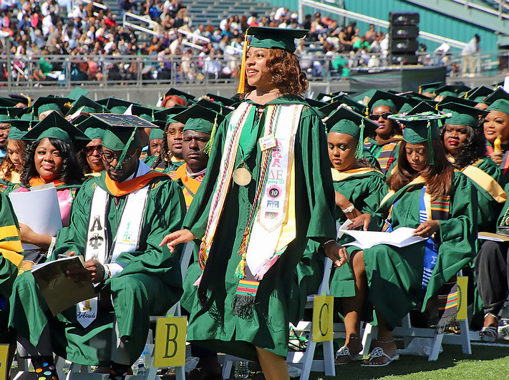
Ordering the Correct Regalia
When ordering a bachelor's, master’s, or doctor's hood, you will need to know what colors you want for each of these four areas:
Fabric Color: The standard fabric is green.
Velvet Color: Based on degree and discipline.
Field Color: 1st school color, in the large area.
Chevron Color: 2nd school color, in the center area. Your school may have from zero to three chevrons. Associate (AA) Degree Cowls require only a chevron and field color and come only in Velveteen fabric.

Slide 16
Hood Colors
In determining what you need, you first need to know a bit about choosing colors. Your hood velvet color is the color of your discipline (for example, Purple is the color of the Law discipline). The inside of the hood includes a field color, and may contain one or more chevrons, all of which represent your school colors. For more information, please contact the NSU Bookstore at (757) 823-2037.
Doctoral Degree Candidates: Green Tam/Gold Tassel/Green Gown/Doctorate Hood
Norfolk State University awards the Doctor of Philosophy degree. The gold tassel is worn to the left, signifying the possession of an academic degree. The doctor’s gown has voluminous sleeves with three velvet chevrons, and velvet facing down the front openings of the gown.
Colors listed below designate the proper doctorate hood color:
Master’s Degree Candidates: Green Cap/Green Tassel/ Green Gown/Hood
The green tassel on the master’s cap is worn to the left signifying the possession of an academic degree. The master’s gown is designed with oblong sleeves, open at the wrist. The field of study is indicated by the color of the velvet on the facing of the hood.
Colors listed below designate the proper master’s hood color:
Major | Hood Color
Community/Clinical Psychology | White
Computer Science | Golden Yellow
Criminal Justice | Midnight Blue
Cyberpsychology | Blue
Cybersecurity | Orange
Electronics Engineering | Orange
Healthcare Administration | Peacock Blue
Media and Communications | Crimson
Music | Pink
Public Health | Salmon Pink
Special Education | Light Blue
Urban Affairs | Blue Violet
Urban Education | Light Blue
Visual Studies | Brown
Social Work | Citron
Doctor of Philosophy (Ph.D.) | Hood Color
Clinical Psychology | White
Materials Science and Engineering | Ph.D. Blue or Orange
Social Work | Ph.D. Blue or Citron

Slide 17
Bachelor’s Degree Candidates: Green Cap/Tassel/Green Gown
The cap is worn parallel to the floor. Undergraduates, who have not yet earned a first degree, wear the tassel forward and to the right. During the ceremony when directed the tassel is moved to the left, signifying the conferring of the degree.
Colors listed in the chart designate the proper bachelor’s hood color listed by college/school:
School / College | Major | Hood Color
COLLEGE OF SCIENCE, ENGINEERING, AND TECHNOLOGY | Biology | Golden Yellow
 | Building Construction Technology | Orange
 | Chemistry | Golden Yellow
 | Computer Science | Golden Yellow
 | Computer Technology | Golden Yellow
 | Design Technology | Orange
 | Electronic Technology | Orange
 | Engineering (all disciplines: Electronics and Optical) | Orange
 | Health Services Management | Olive Green
 | Mathematics | Golden Yellow
 | Medical Technology | Green
 | Nursing | Apricot
 | Physics | Golden Yellow
SCHOOL OF BUSINESS | Accountancy | Drab
 | Business (all disciplines: MIS, Finance, Management, Marketing, Entrepreneurship, and Business Education) | Drab
 | Tourism and Hospitality Management | Drab
SCHOOL OF EDUCATION | Early Childhood Education | Light Blue
 | Exercise Science/Health and Physical Education | Sage Green
SCHOOL OF SOCIAL WORK | Social Work | Citron
School / College | Major | Hood Color
COLLEGE OF LIBERAL ARTS | Drama and Theater | Brown
 | English | White
 | Fine Arts and Graphic Design | Brown
 | History | White
 | Interdisciplinary Studies | White
 | Journalism | Crimson
 | Mass Communications | Crimson
 | Music | Pink
 | Political Science | White
 | Psychology | White
 | Sociology | White

Slide 18
Dress and Decorum
All graduates, except those being commissioned in ROTC, are required to wear academic attire (Mortar boards and gowns).
Mortar boards (hats) are worn with the tips in a horizontal position – not tilted. All undergraduates and candidates for associate degrees march with tassels on the right side of their hats. Graduate students always wear their tassels on the left side during the ceremony.
Men wear hats throughout the program except during the Invocation, National Anthem and Benediction.
Women do not remove their hats during the ceremony.
Professional and/or business attire should be worn under robes.
Purses are not to be carried in the processional. Provisions should be made to leave them with family or friends.
Cellular telephones and/or any electronic devices are not to be used at any time during the ceremony.
Associate Degree Candidates: Green Cap/Tassel/Green Gown
The cap is worn parallel to the floor. Candidates should wear tassels forward and to the right. When directed during the ceremony, the tassel is moved to the left, signifying the conferring of the degree. The hood for this degree lies flat. The gold binding indicates the wearer has earned the degree of associate in science.
Colors listed below designate the proper associate hood color:
Listing of Honors
A student’s honors designation, if appropriate, will be listed on the permanent academic record (transcript and diploma). The list of students eligible for the honors designations will be in the possession of the person(s) issuing the academic attire. Honors designation will be made based on the last academic semester prior to the semester the candidate applies for graduation. Eligible students may purchase their honors attire during the hours when academic attire is being issued.
Please note: Honor designation pertains to undergraduate candidates only. Graduate students do not have honor designations.
Major | Hood Color
Architectural Drafting | Brown

Slide 19
Important Telephone Numbers
Degree Distribution/Transcript Requests
Degrees will be distributed during the commencement ceremony to students who have no outstanding financial obligations. Students must be financially cleared in order to receive degree and/or transcripts. This includes payment of the graduation fees, tuition and all other fees (Cashier’s Office, Student Services Center, 2nd floor, Room 209) as well as any outstanding parking (University Police Department) or library fines (Lyman B. Brooks Library Circulation/Reserve Department, 1st floor).
Procedures on how to request official transcripts can be found online at www.nsu.edu/registrar. Costs are $3.00 per copy for in-person or mailed requests, and $5.50 per copy for online requests. The standard processing time is 10 business days.
Professional Photography
A photography studio, contracted by the University, will provide a photographer that will take a picture of each graduate as he/she crosses the stage and receives his/her diploma cover. Proofs and purchase information will be mailed or emailed directly to each graduate at the address that is provided on the back of the name card. Name cards will be distributed at 7:00 a.m. on Commencement Day.
NSU Campus Information 757-823-8600 https://www.nsu.edu | Office of Alumni Relations 757-823-8135 https://alumnirelations.nsu.edu
Bookstore 757-823-2037 https://norfolkstate.bncollege.com | Office of the Registrar (Transcripts) 757-823-8377 https://www.nsu.edu/registrar
Career Services 757-823-8462 https://www.nsu.edu/career-services | School of Graduate Studies and Research 57-823-8015 https://www.nsu.edu/sgsr/contact-us
Commencement Event Questions 757-823-8323 https://www.nsu.edu/graduation/information | Student Accounts 757-823-9293 https://www.nsu.edu/studentaccounts
Financial Aid 757-823-8381 https://www.nsu.edu/financial-aid/information | Ticket Office 757-823-9009 https://nsuspartanstickets.universitytickets.com/w/

Slide 20
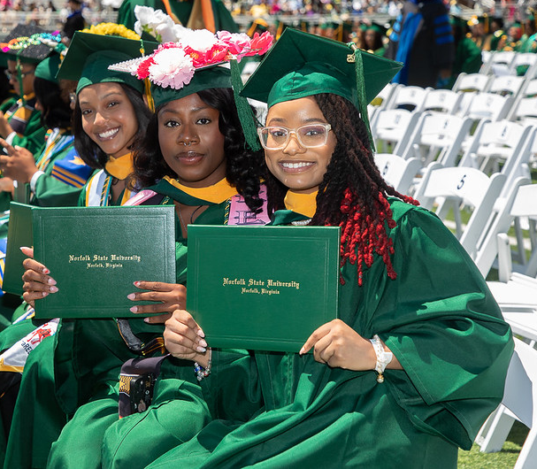
Congratulations
Graduates
*disclaimer: Information is subject to change without notice
disclaimer “Information is subject to change without notice.”

Slide 21

THANK YOU
Commencement Spring 2026 sponsor

