Slide 1
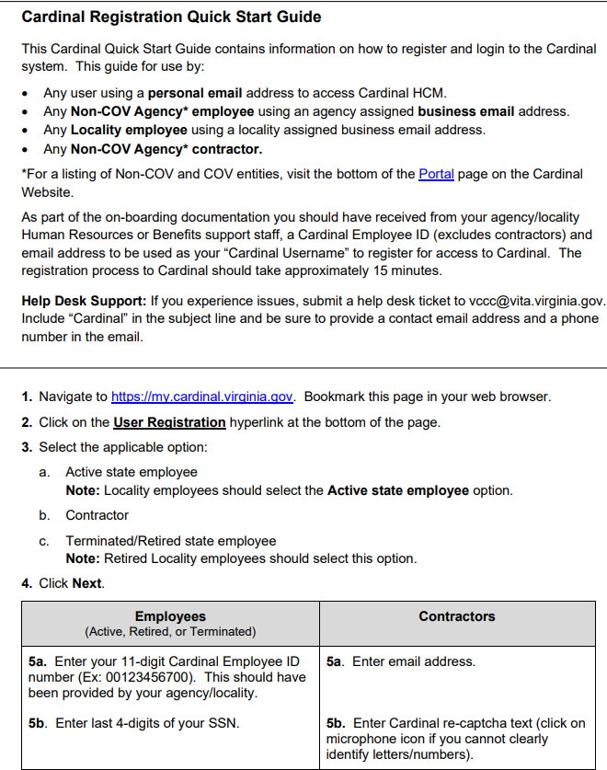
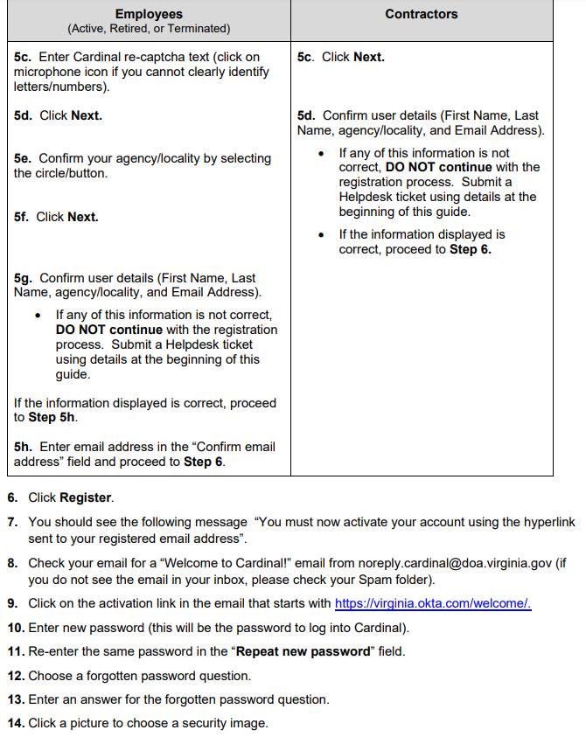
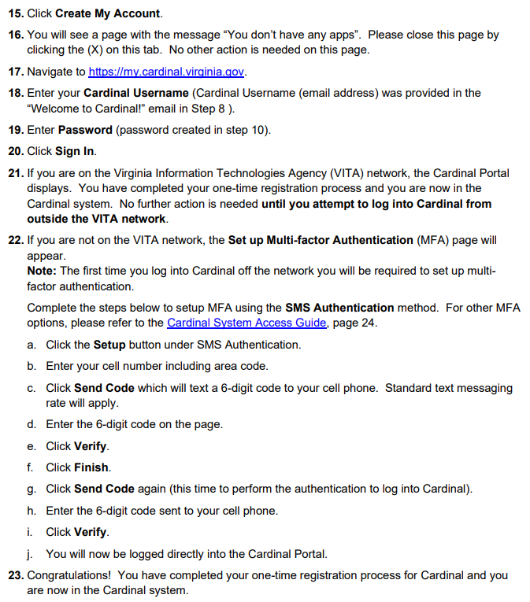
How to register for Cardinal
Utilize the Cardinal Registration Quick Start Guide

Slide 2
How to use Cardinal
Logging into Cardinal HCM:
Visit https://my.cardinal.virginia.gov/ & enter your username and password created during the registration process.
Start using Cardinal HCM:
Check and review all applicable personal information (i.e., name, and address).
Let your agency HR team know if there are any issues with this data.
Resources & Support:
Introduction to Employee Self-Service Videos
Training materials: Cardinal HCM User Resources guide.
If the resources above do not solve your issue, use the following:
  Occasional user? Cardinal HCM ESS Support Guide
  Daily Administrative user/completed Instructor-Led Training Cardinal HCM Core User Support Guide
Submit a help desk ticket to vccc@vita.virginia.gov and include the word “Cardinal” in the subject line. Be sure to include your name, email address, and a phone number where you can be reached.

Slide 3
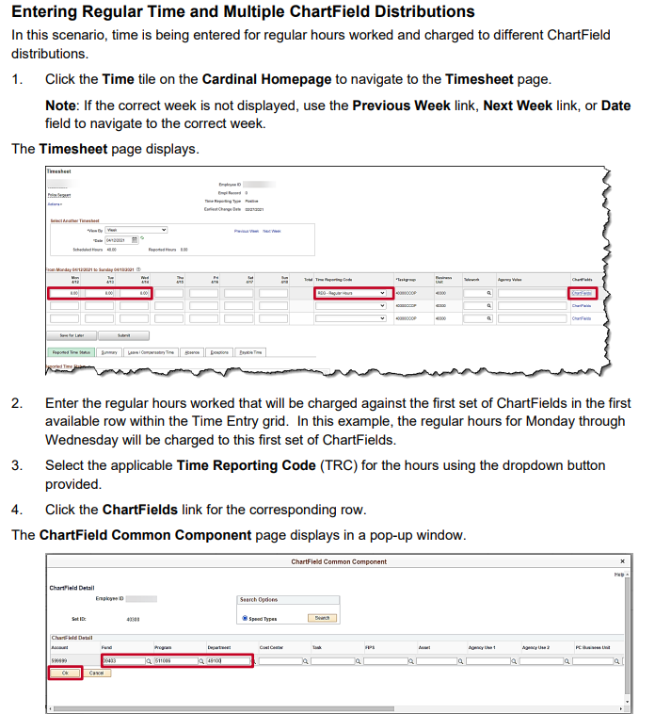
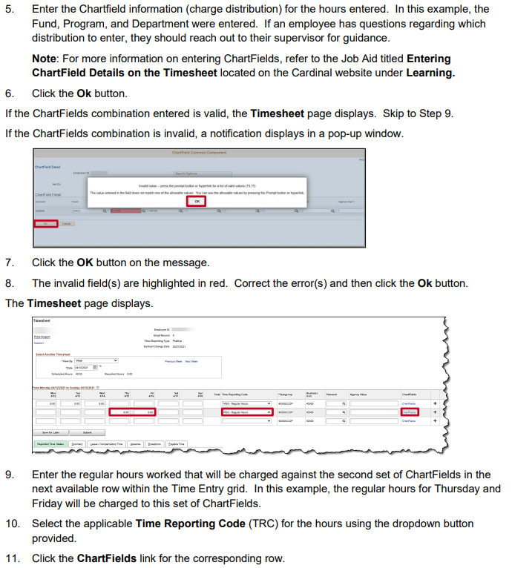
How to enter time onto a timesheet

Slide 4
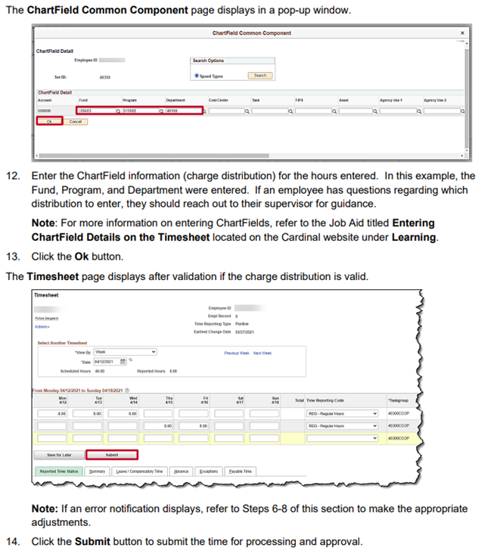
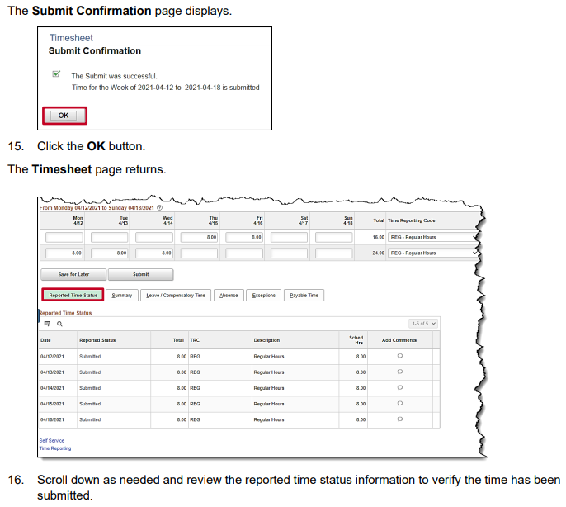
How to enter time onto a timesheet

