Slide 1

Supervision of Counseling Practicum and Internship Students:
Site Supervisor Training
Norfolk State University
Counselor Education Programs
Secondary Education and School Leadership

Slide 2


Welcome to the NSU Counseling Supervision Training
The purpose of this training
to assist site supervisors to provide the best counseling practicum/internship experience for emergent counselors at Norfolk State University
become familiar with the university practicum/internship processes

Slide 3

Welcome to the NSU Counseling Supervision Training
Before beginning the training
Have the patience and commitment to train an eager and inexperienced student
Have at least 90 minutes of time to complete the training
Have a printer or method to save the completion certificate
Have a memorandum of agreement with the university

Slide 4

Defining Supervision
Supervision is the process of an experienced practitioner providing feedback and sharing expertise with a supervisee who is a less experienced professional
  The focus of supervision:
    Developing emergent practitioners
    Completing the requirements for an academic degree
    Pursuing professional licensure

Slide 5
Defining Supervision
Supervision is the process of teaching, mentoring, coaching, advising and guiding a professional in training or a beginning professional by an experienced professional (Bradley & Kottler, 2001; Bernard & Goodyear, 2018)
Can be clinically focused or administratively focused
Can be structured hierarchically or as peer supervision

Slide 6
Defining Supervision
“Education and training aimed at developing science-informed practice. . . facilitated through a collaborative interpersonal process. Supervision ensures that clinical consultation is conducted in a competent manner in which ethical standards, legal prescriptions, and professional practices are used to promote and protect the welfare of the client, the profession and society at large.” (Falender & Shafranske, 2004c).
“Clinical supervision is a disciplined, tutorial process wherein principles are transformed into practical skills. . . .” (Powell, D.B. & Brodsky, A. 2004)

Slide 7
Defining Supervision
Clinical supervision “is a working alliance targeted toward goals of mastery of specific skills, a broader scope of concern for the client, awareness of one’s own impact on the counseling process, and translation of theory into practice. . . . It is an “intensive, evaluative, ongoing and demanding relationship . . . that encourages both vulnerability and independence.” (Powell & Brodsky, 2004)

Slide 8
Defining Supervision
CACREP
Supervision is defined by the Council for the Accreditation of Counselor Education and Related Programs (CACREP) as:
A tutorial and mentoring form of instruction in which a supervisor monitors the student’s activities in practicum and internship and facilitates the associated learning and skill development experiences. The supervisor monitors and evaluates the clinical work of the student while monitoring the quality of services offered to clients (CACREP, 2013).

Slide 9
Defining Supervision
ACES
The Association for Counselor Education and Supervision (ACES) (1993) explains that the supervisory role of counseling supervisors includes:
  ensuring that practices support client welfare
  promoting ethical, legal and professional standard compliance
  observing and critiquing professional practice and professional development
  evaluating professional performance and potential

Slide 10
ACES Standards for Effective
Counseling Supervisors Include
effective counselors with appropriate training
committed to embodying personal characteristics congruent with role of professional supervisor
knowledgeable and able to apply ethical, regulatory and legal principles of profession
actively aware of professional and personal context of supervision and supervisory relationship
competent and consistent in applying professionally supported supervision methods and techniques

Slide 11
ACES Standards for Effective
Counseling Supervisors Include
aware of the developmental processes of counselor growth
competent in case conceptualization and management of clinical cases
competent in client assessment and evaluation
competent in professional documentation, both verbal and written
competent in counselor evaluation, and
knowledgeable of contemporary counseling and supervision research

Slide 12
Counseling Education Supervision
To promote the professional, personal and clinical skill development of counselors
Supervision offers fresh, diverse perspectives and challenges supervisees to reflect on their professional practice, personal strengths and personal challenges.
Through a continuing cycle of reflection, action, and feedback, the supervisee is able to develop increased professional competence, personal awareness and clinical fortitude.

Slide 13
Counseling Education Supervision
Foundations
Integrity,
Ethical values-based practice,
Respect for diversity in all its forms, and
Science-informed practice.

Slide 14
Counseling Education Supervision
Process and Practice
Clinical supervision “is a working alliance targeted toward goals of mastery of specific skills, a broader scope of concern for the client, awareness of one’s own impact on the counseling process, and translation of theory into practice. . . . It is an “intensive, evaluative, ongoing and demanding relationship . . . that encourages both vulnerability and independence.”
Learning to identify the interventions (what) and the principles (why) of therapeutic process. A supervisee may be quite empathic and intuitive, but “entry-level counselors lack the grounding needed for identifying what they did and why they did it. . . . They have minimal background in conceptualizing treatment plans and justifying specific clinical interventions” (Powell and Brodsky, 1998).

Slide 15


Key Points in Counseling Supervision
Working collaboratively to determine needs,
Effectively communicating,
Establishing and planning goals, and evaluating them ongoing,
Listening with compassionate and understanding,
Being responsive,
Providing referrals and recommendations as needed,
Being affirming, and encouraging to instill confidence and motivation,
Following up and following through.

Slide 16
Key Points in Counseling Supervision
Commitment to supporting the well-being of clients
Demonstration of the appropriate academic preparation and professional experience
Commitment to promoting positive relationships and supporting the development of supervisees
Understanding and adhering to professional ethical codes and mandates
Modeling empathy, genuineness, and active listening
Evidence of flexibility and praise as well as critical feedback to clients
Demonstrates the promotion and engagement in self-reflection

Slide 17
The Supervision Relationship (supervisor-supervisee)
Bordin (1983) articulated three components necessary for an effective supervisory working alliance, or supervision relationship:
Shared agreement and understanding about goals and expectations for supervision
Shared understanding and expectations of the work or tasks for supervision
Positive emotional bond or relationship between supervisor and supervisee

Slide 18
The Supervision Relationship (supervisor-supervisee)
The supervision relationship should focus on the development, enhancement and evaluation of the supervisee’s skills, knowledge and behavior.
Supervisees perform best when the relationship with their supervisor is well established and strong.
Effective supervision leads development of professional identity, personal-professional integrity and ethical behavior.

Slide 19
The Supervision Relationship
(supervisor-supervisee)
Requires understanding of developmental trajectory of counselors-in-training
Offered individually and through university-based group supervision sessions
Requires weekly individual site-based sessions
Site supervisor provides orientation to site expectations, mission, philosophy and practices for student intern
Site supervisor works with student to identify and allow access to appropriate professional activities
Culminates in a formal summative evaluation

Slide 20
The Supervision Relationship
Expectations for Supervisee
Works diligently to provide ethical and effective counseling services!
Comes to supervision prepared and ready to engage!
Provides opportunities for observation of professional practice (live or taped)
Intentionally reflects upon the therapeutic skills he/she hopes to develop and/or enhance through supervision
Actively works with supervisor to develop goals for supervision and professional development
Demonstrates open-mindedness
Brings a willingness to reflect upon personal feelings, characteristics and professional competence
Works actively to minimize personal resistance
Works collaboratively with supervisor to critically evaluate supervision experience

Slide 21
Theoretical Frameworks for Supervision
Psychodynamic Theoretical Framework
Behavioral Theoretical Framework
Cognitive Theoretical Framework
Developmental Theoretical Framework

Slide 22
Theoretical Framework for Supervision
Psychodynamic Theory
Conceptualizes supervision as a therapeutic process focused on relational dynamics between supervisee and clients, supervisor, colleagues and others
Tripartite model
  Didactic curriculum
  Supervised client analysis
  Personal analysis of supervisee

Slide 23
Theoretical Framework for Supervision
Psychodynamic Theory
Foundational Assumptions
  Parallel process between counseling and supervision, conflicts are acted out in each
  Learning occurs through internalization
  Interpersonal dynamics are of primary importance
  Both verbal and nonverbal communication is key to observe
  Intrapersonal dynamics provide opportunities to observe and make-meaning of covert behaviors, cognitive routines and sensory processes
  Supervisory relationship consistent with counselor and client therapeutic alliance

Slide 24
Theoretical Framework for Supervision
Psychodynamic Theory Methods
Unstructured psychodynamic supervision – examine and explore supervisee’s dynamic interactions with clients, consultees, colleagues and supervisor
  Four areas of Focus:
    Dynamic awareness
    Understanding dynamic contingencies
    Dynamic change
    Therapeutic utilization of dynamics

Slide 25
Theoretical Framework for Supervision
Behavioral Theory
Competent, effective counseling requires learned skills
Purpose of supervision – to teach skills and extinguish behaviors that are not effective or appropriate (Rosenbaum & Ronen, 1998).
Focused primarily on application and refinement of skills learned through counselor education preparation

Slide 26
Theoretical Framework for Supervision
Behavioral Theory
Goals are developed to address the skill needs of supervisee!
Strategies include:
  Analysis and assessment of skills and abilities
  Goal setting
  Developing and implementing action plans
  Self-directed learning activities
  Self-assessment
  Peer supervision
  Modeling
  Reinforcement
  Role playing & simulation
  Development and implementation of self-management strategies
  Evaluation of strategies and interventions

Slide 27
Theoretical Framework for Supervision
Cognitive Theory
Perceptions, affect and behaviors are founded in one’s cognitive conceptualization of one’s world
Overarching, flexible supervisory framework
Interpersonal process focused on technique development and self-awareness of cognitive processes impacting supervision and counseling
Services as a double matrix model.
  the supervisor pays attention to the supervisee-client relationship
  the supervisor-supervisee relationship.

Slide 28
Theoretical Framework for Supervision
Cognitive Theory
The primary goal of supervision is to provide clients with care that is properly and competently managed, in which both supervisor and supervisee measure the clients' progress and outcomes (Swift et al., 2015)
Three Areas of Focus:
  Gain knowledge and develop competency in application of cognitive therapy skills/techniques and strategies
  Identify and modify misconceptions
  Identify and work to address personal issues of supervisee impacting clinical practice and professional development

Slide 29
Framework for Supervision
Cognitive Theory
1 hour weekly sessions
Biweekly group supervision
Individual supervision structure
  Initial greeting/conversation
  Set agenda
  Review concepts and skills discussed in previous session
  Review assigned homework
  Move to agenda items
  Assign homework
  Offer feedback (both supervisor and supervisee)
  Close session
Techniques and strategies are drawn from Cognitive Theory and Cognitive-Behavioral Theory

Slide 30
An understanding of the developmental process of supervisees can be incorporated into all theoretical
frameworks of supervision.
However, in using a defined Developmental Theoretical Framework for practice, the developmental process takes precedence.

Slide 31
Theoretical Framework for Supervision
Integrative Developmental Theory
Fundamentals
In defining the Developmental Theoretical Framework for counseling supervision, the developmental process takes precedence in order to provide support and opportunities for reflection about engagement in professional experiences
An understanding of the developmental process of supervisees can be incorporated into all theoretical frameworks of supervision
The goal of the integrative developmental theory is to promote personal and professional therapist growth through three developmental levels by closely attending to the three overriding structures of Self- and Other-Awareness, Motivation, and Autonomy across eight domains of clinical practice including intervention skills competence, assessment techniques, individual differences, and professional ethics

Slide 32
Theoretical Framework for Supervision
Integrative Developmental Theory
Foundational Assumptions
  Development is viewed as a change over time in cognitive complexity, differentiation and ultimately integration
  Recognizes that counselors may gain more technical skills over time, but that support and reflection are necessary for increased complexity of understanding and application of gained skills
  Initial learning is more general and specificity increases over time with exposure to diverse experiences: environment provides experiences, supervision provides reflection and integration!
  Progression through developmental stages can be positively impacted and supported by clinical supervision
  Supervision supports a “transformation in identity”

Slide 33
Theoretical Framework for Supervision
Integrative Developmental Theory
Role of Supervisor
To provide opportunities for diverse professional clinical and administrative experiences
To provide support and opportunities for reflection about engagement in professional experiences
To challenge supervisees to seek to expand understanding, skills and awareness
To understand critical need for balance of challenge, support and reflection to promote development and to fully integrate these opportunities into practical experience for supervisees

Slide 34
Developmental Levels of Supervisees
Level 1 Supervisee:
Lacks confidence, highly self-conscious with performance, anxious about evaluation, shows confusion about appropriate behaviors for professionals, discomfort motivates actions, highly dependent on modeling and directive in supervision
Level 2 Supervisee:
Whiles understand and is aware of the worldview of the client, struggles to retain objective, increased confidence in ability to empathize, increased engagement in the supervision process and decreased preoccupation with individual performance, somewhat erratically motivated, can be overwhelmed by potential options and choices for treatment, transitioning from dependency to autonomy in supervision
Level 3 Supervisee:
Demonstrates more confidence, objectivity and intentionality, mindful of dynamics in counseling – interpersonal, intrapersonal and process dynamics, consistently motivated to enhance professional skill and identity, functions independently and responsibly
Stoltenberg, McNeill & Delworth, 1998

Slide 35
Developmental Levels of Supervisees
Level 1 Supervisee:
Lacks confidence, highly self-conscious with performance,
anxious about evaluation,
demonstrates confusion about behaviors appropriate for professionals,
discomfort motivates actions,
highly dependent on modeling and directive in supervision

Slide 36
Developmental Levels of Supervisees
Level 2 Supervisee:
aware of and attuned to the worldview of the client but may struggle to retain objectivity,
more confident in ability to empathically relate, more engaged in process and less preoccupied with individual performance,
somewhat erratically motivated,
at times overwhelmed by potential options and choices for treatment, transitioning from dependency to autonomy in supervision

Slide 37
Developmental Levels of Supervisees
Level 3 Supervisee:
Demonstrates marked self- assurance, objectivity and intentionality,
Aware of dynamics in counseling – interpersonal, intrapersonal and process dynamics,
consistently motivated to enhance professional skill and identity, functions independently and responsibly

Slide 38
Developmental Supervision Strategies
Typically fall under one of four categories:
  Teaching
  Counseling
  Consulting
  Combined
  In the following slides, “session observation” may refer to either live observation or taped session observation

Slide 39
Supervision Strategies: Teaching
Evaluate interactions, behaviors and techniques during session observation
Identification of appropriate and inappropriate interventions
Demonstrating and modeling interventions
Discussing and explaining rationale for using strategies
Interpreting significant events
Formulating hypotheses about cases

Slide 40
Supervision Strategies: Counseling
Exploration of supervisee feelings experienced during counseling sessions or supervision sessions
Facilitation of supervisee self-exploration of confidence and challenges
Facilitation of supervisee’s identification of personal competencies and goals for growth
Provision of opportunities for self-reflection and processing of supervisee affect and perceptions

Slide 41
Supervision Strategies: Consulting
Promote potential intervention brainstorming by supervisee
Encourage supervisee direction of supervision session agenda and goals
Engage in case staffing including client problems and motivations
Provide interventions, strategies and information for supervisee to explore
Encourage supervisee to discuss personal supervision needs and work to address these needs

Slide 42
Supervision Strategies: Combined
Engage with the supervisee in case conceptualization
Use the exploration of supervisee’s feelings to more fully understand client
Present developmental challenges to promote growth
Use parallel process to model strategies
Explore boundary issues
Facilitate the supervisee’s processing of feelings and distress prompted by client’s presenting concern and experiences
Work with supervisee to identify and appropriately use cues derived from client and counselor behaviors
Reframe supervisee’s ideas and behaviors to promote growth

Slide 43
Cultural Competency in Supervision
Essential to integrate a focus on cultural competency in order to promote culturally-competent practice by supervisees!
Cultural competence includes:
  Self-awareness of values, biases and beliefs
  Understanding of worldview of culturally-diverse clients
  Development and implementation of culturally- appropriate interventions (Ancis & Ladany, 2001)

Slide 44
Cultural Competency in Supervision
Five domains within which to assess cultural competency and integrate cultural awareness, discussions and strategies for competence
  Personal development
  Conceptualization of cases
  Identification and implementation of interventions
  Process: within counselor-client relationship and dynamics and supervisor-supervisee relationship and dynamics
  Evaluation

Slide 45
Supervisee Evaluation
Evaluation is the primary difference between supervision and counseling (Inskipp, 1996)
Purpose of Evaluation in Supervision:
  To assess effectiveness of supervisee’s professional counseling practice in order to enhance and improve that practice
  To provide feedback to supervisee
  Additional purposes include: to serve as a gate-keeper for the profession and to assess how week supervisee meets site standards and expectations

Slide 46
Supervisee Evaluation: Methods
Using the supervisory contract developed and agreed upon at the beginning of supervision
Focus on goal-attainment
Use a combination of
  Progress reviews
  Self-evaluation
  Site-specific Evaluation Instruments
  Process-measurement Instruments
  Outcome Measurement Instruments
  Multicultural Competency Assessment Instruments

Slide 47
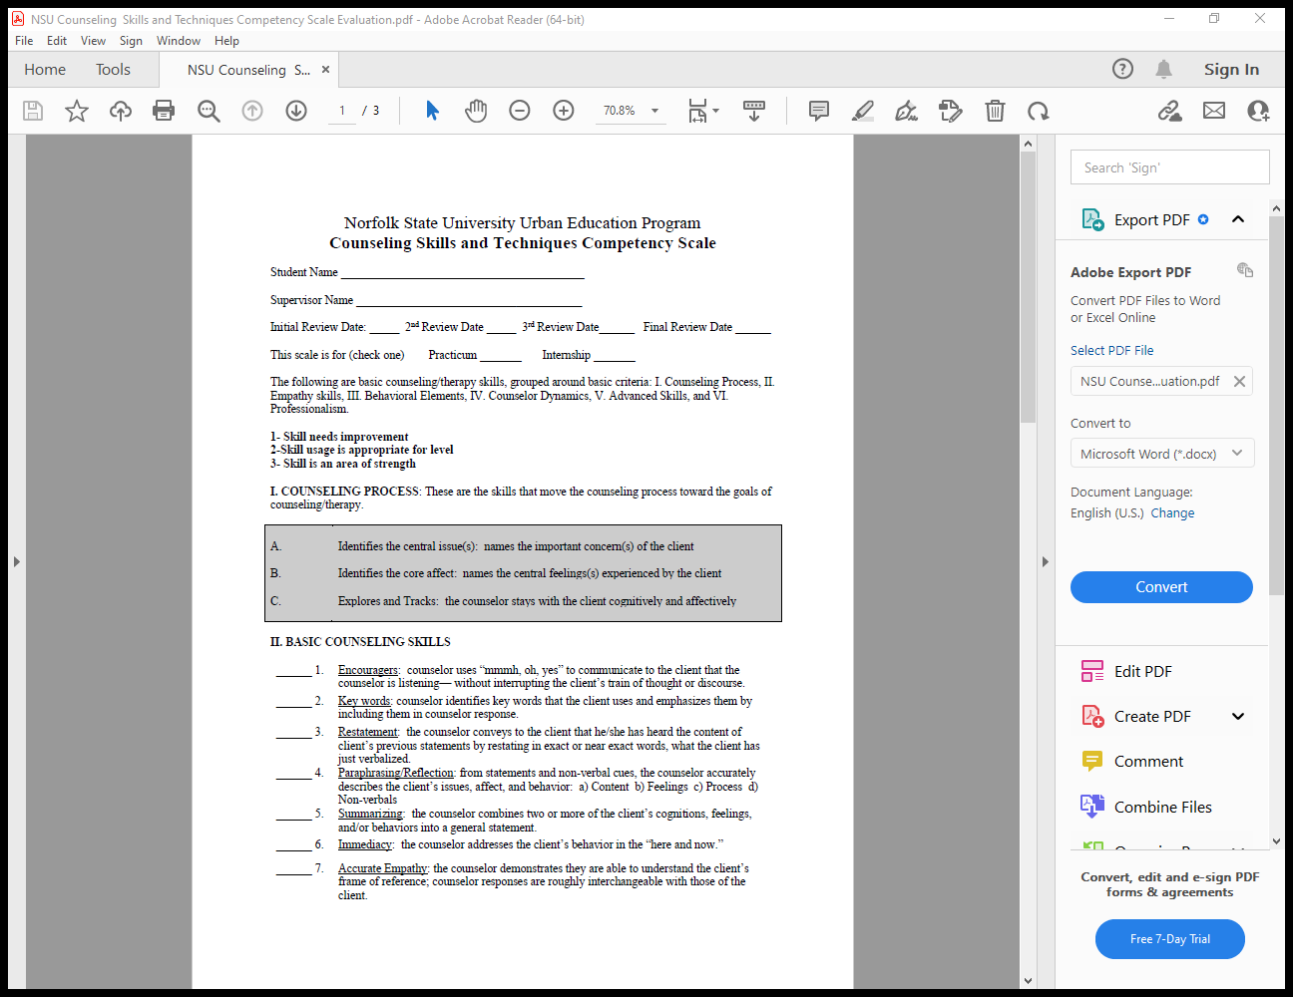


Evaluation Tool:
NSU Counseling Competency Scale

Slide 48
Supervisor Evaluation
Evaluation is the primary difference between supervision and counseling (Inskipp, 1996)
Purpose of Supervisor Evaluation:
  To assess effectiveness of on-site supervision
  To provide feedback to supervisor
  Additional purposes include: to match future practicum and internship students based on student’s needs

Slide 49

Evaluation Tool:
NSU Site Supervisor Feedback

Slide 50
Program Evaluation
Evaluation is the primary difference between supervision and counseling
Purpose of Program Evaluation in Supervision:
  To assess effectiveness of program in student preparation for counseling field experiences
  To provide feedback to program coordinator for curriculum alignment purposes
  Additional purposes include: to feedback to course instructors that serve as input for course modifications and improvements

Slide 51

Evaluation Tool:
NSU Site Supervisor Program Feedback

Slide 52
Student Documentation
Weekly Counseling Log
Students use counseling log form to record direct and indirect hours. Both counseling student and site supervisor officially sign the form.
Required hours for counseling practicum
  100 hours (60 indirect hours and 40 direct client hours)
Required hours for counseling internship
  600 hours (360 indirect hours and 240 direct client hours)
  Direct hours include: shadowing clinicians, session observations, client assessments, conducting individual sessions and groups, other activities directly involving clients.
  Indirect hours include: writing treatment plans, client research, writing lesson plans, attending meets without clients, filing, trainings, agency community actives.

Slide 53
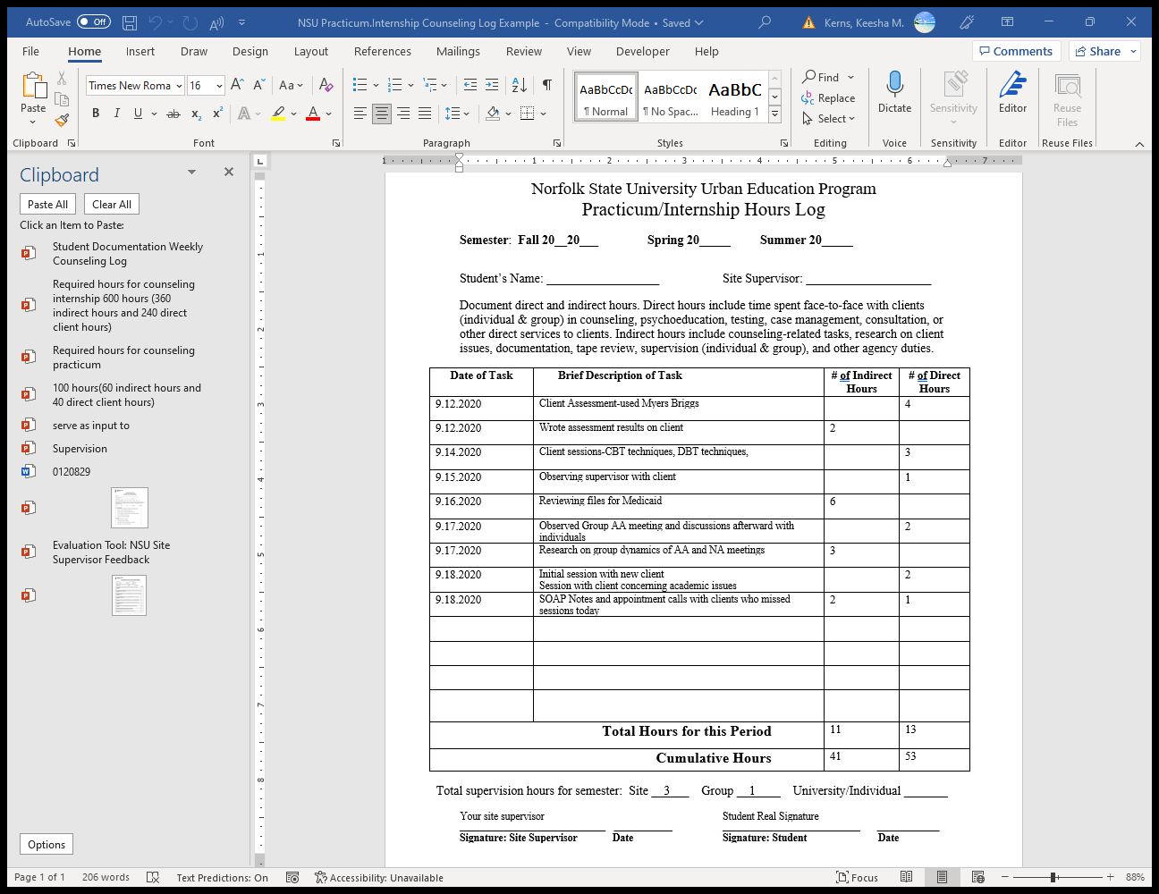
Student Documentation
MHC Weekly Counseling Log

Slide 54
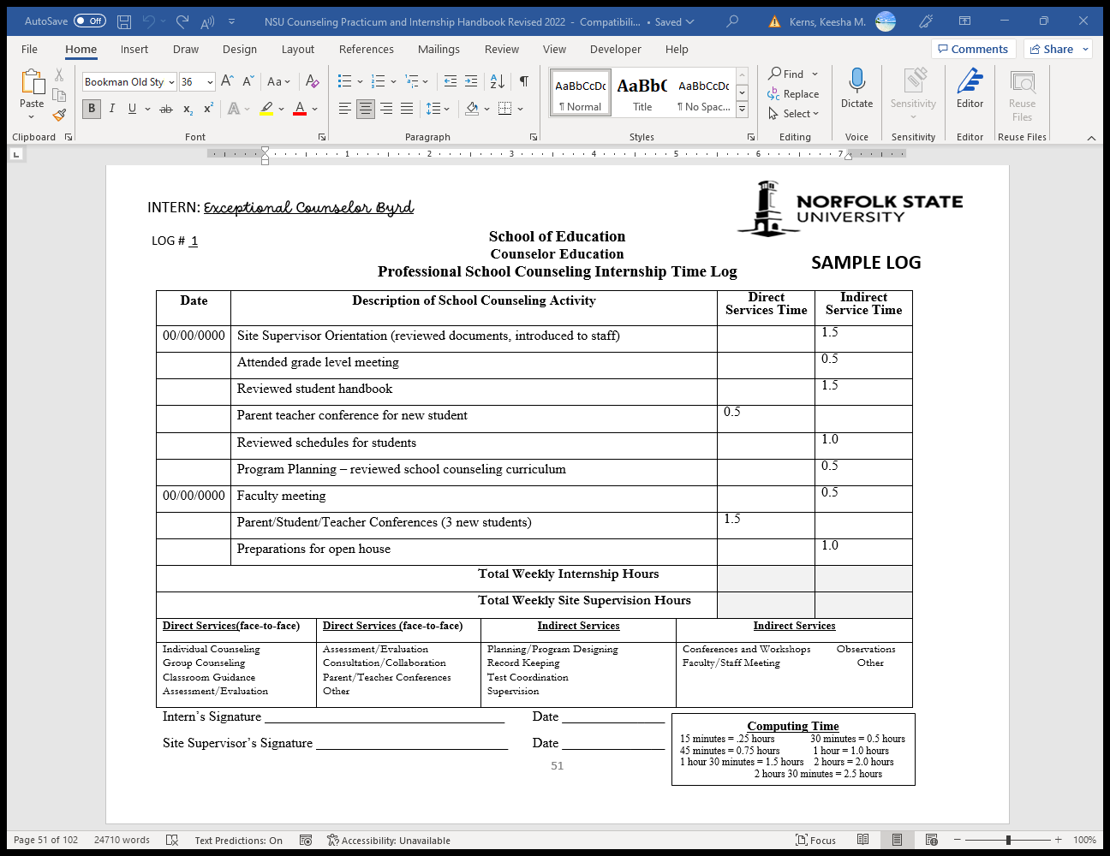
Student Documentation
PSC Weekly Counseling Log

Slide 55
Student Documentation
Counseling Foursquare
Designed to document supervision sessions for both practicum and internship counseling students and site supervisor.
Counseling practicum/internship student brings concerns and or issues to supervision on this form
  The student initials the student’s portion of the form.
The supervisor address the concerns and provides recommendations to the student.
  Site supervisor initials the supervision’s portion of the form
  The student must then respond to how they will use the supervisor’s recommendation to address the concern.
    The student initials the use of feedback portion of the form.

Slide 56
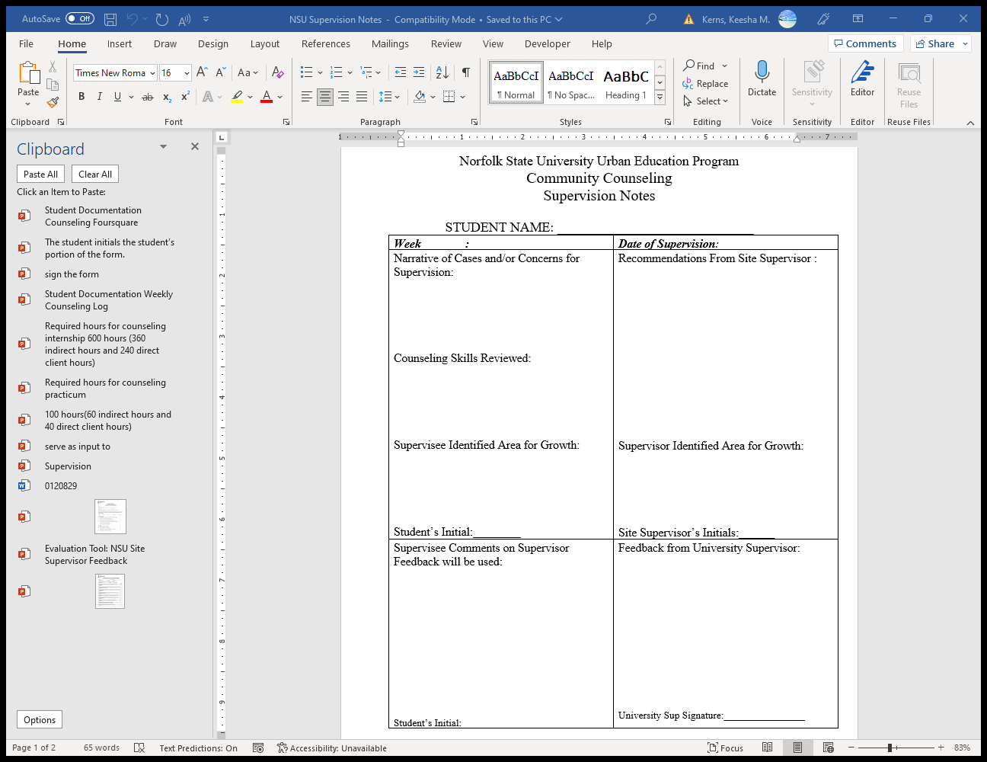
Student Documentation
Counseling Foursquare

Slide 57
Student Documentation
Supervision Attendance Log
Designed to document supervision sessions for both practicum and internship counseling students and site supervisor.
Dates on supervision foursquare should match does of individual supervision the supervision attendance log.
The supervision can include group supervision without a supervision foursquare.
  Both counseling student and site supervisor must officially sign the supervision attendance log form.
  Students are to submit the supervision attendance log with supervision foursquare attached at requested times throughout the semester.

Slide 58

Student Documentation
Supervision Attendance Log

Slide 59
Student Documentation
Site Agreement
Designed to document the who will be the student’s onsite counseling supervisor.
Includes information concerning the supervisor’s credentials and experience working in supervision.
Provides the site and site supervisor’s direct contact information.
Gives duration of practicum/internship students assignment to site.
Outlines expectations of site supervisor and practicum/internship student supervisee
  Must be officially signed by both counseling student and site supervisor.

Slide 60
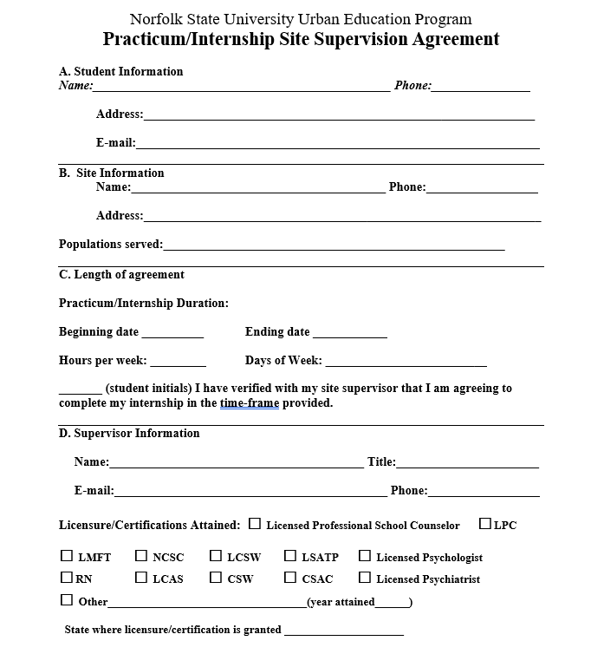

Student Documentation
MHC Site Agreement

Slide 61
Ethical Issues in Counseling Supervision
There are many ethical issues to consider when entering and engaging in a supervision relationship, including, but not limited to:
  Dual relationships
  Gate-keeping
  Supervisor expertise and limitations
  Modeling ethical behavior
  Responding to ethical concerns
  Cultural competence and evaluation of cultural competence in practice
  Differentiation between supervision and counseling
  Sexual attraction and contact
  Management of termination and follow-ups

Slide 62
Ethical in Guidelines Counseling Supervision
Assess your competency as a supervisor and be actively aware of your areas of professional expertise
Ensure that your practice is based on current professional knowledge and standards
Set appropriate boundaries
Provide appropriate disclosures to supervisees
Transparency is key!
Formulate a plan for crisis coverage and intervention
Assess dual roles and act appropriately
Maintain active, open lines of communication and collaboration with supervisees
Maintain a commitment to culturally competent practice and supervision
Seek your own supervision when necessary

Slide 63
Ethical Codes in Counseling
Supervision
Association for Counselor Education and Supervision. (1995). Ethical guidelines for counseling supervisors. Counselor Education and Supervision, 34, 270-276.
  www.acesonline.net/doc/ethical_guidelines.htm
  American Counseling Association Code of Ethics (2014) https://www.counseling.org/resources/aca-code-of-ethics.pdf

Slide 64

Promoting Best Practices Supervision Tips
Ensure you have the time to serve as a supervisor,
Regulate the number of supervisees you take on,
Maintain good notes from your supervision sessions,
Establish a supervision agreement with the supervisee,
Facilitate the supervisee assessment process to include (knowledge, skill) to determine supervisee needs and areas of focus; adjust accordingly.

Slide 65
Promoting Best Practices Supervision Tips
Model supervision counseling behavior while in supervision
Observe supervisees’ verbal and nonverbal cues during supervision
Promote professional growth & development of supervisee
Assess peer review and university supervisor feedback of supervisee
Provide constructive, honest, and useful feedback during supervision

Slide 66
NSU Counseling Supervision Quiz Questions
Please click on the correct answer to complete the quiz questions.

Slide 67
NSU Counseling Supervision
Quiz Question 1
The purpose of evaluation in supervision is to
assess effectiveness of supervisee’s professional counseling practice in order to enhance and improve that practice
find problems that supervisees have in their past
Correct answer: A

Slide 68
NSU Counseling Supervision Quiz Question 2
The purpose of counseling education supervision is to
gatekeep the counseling profession
promote the professional, personal and clinical skill development of counselors
Correct answer: B

Slide 69
NSU Counseling Supervision Quiz Question 3
ACES is the governing body for counseling supervision. ACES stands for
The Association for Counselor Education and Supervision
The American Counseling Education Supervisors
Correct answer: A

Slide 70
NSU Counseling Supervision Quiz Question 4
Counseling supervisors should model supervision counseling behavior while in supervision.
True
False
Correct answer: A

Slide 71
NSU Counseling Supervision Quiz Question 5
In counseling supervision cultural competence includes self-awareness of values, biases and beliefs and forcing the supervisees views on the clients.
True
False
Correct answer: B

Slide 72
Certification Slide
Instructions:
Add your name on the certificate line and print as proof of course completion.
Email a copy of the certification back to Dr. Kerns at kmkerns@nsu.edu to be added to the counseling site’s Memorandum of Agreement folder.

Slide 73
Evaluation
Please use the link below to complete the training evaluation form. If you have any questions or issues, please email sesl2@nsu.edu.
https://forms.office.com/Pages/ResponsePage.aspx?id=XSuPhKnBxUeoJW4zH7LkESAFUMpJb6ZIs58QAHof1mNURTYwRFY5MUdaMkdDSzRSRlpEOEZYU1FBWC4u

Slide 74
Thank You
Thank you for participating in the NSU Site Supervisor training.
Further question please contact the program coordinator or department chair at SESL Department 757.823.2926
Dr. Byrd, SESL Department Chair
mobyrd@nsu.edu
Dr. Kerns, SESL Graduate Program Coordinator
kmkerns@nsu.edu

Slide 75
References
American Counseling Association (2014) Code of Ethics https://www.counseling.org/resources/aca-code-of-ethics.pdf
Ancis, J. R. J. & Ladany, N. (2001). A multicultural framework for counselor supervision. In L. J. Bradley & N. Ladany (Eds.),
Counselor supervision: Principles, process and practice (pp. 63-90). Philadelphia, PA: Brunner-Routledge.
Association for Counselor Education and Supervision. (1995). Ethical guidelines for counseling supervisors. Counselor Education and Supervision, 34, 270-276.
Association for Counselor Education and Supervision. (1993). Ethical guidelines for counseling supervisors. Retrieved from
Bernard, J. M. & Goodyear, R. K. (1998). Fundamentals of clinical supervision (2nd ed.). Boston, MA: Allyn & Bacon.

Slide 76
References
Binder, J. L. & Strupp, H. H. (1997). Supervision of psychodynamic psychotherapies. In C. E. Watkins, Jr. (Ed.), Handbook of psychotherapy supervision (pp. 44-62). New York: Wiley.
Borders, L. D. (2010). Principles of best practices for clinical supervisor training programs. In J. R. Culbreth & L. L. Brown (Eds.), State of the art in clinical supervision (pp. 127–150). New York, NY: Routledge
Bordin, E. S. (1983). A working alliance-based model of supervision. The Counseling Psychologist, 11, 35-42.
Bradley, L. J. & Ladany, N. (2001). Counselor supervision: Principles, process and practice. Philadelphia, PA: Brunner-Routledge.
Bradley, L. J. & Kottler, J. A. (2001). Overview of counselor supervision. In L. J. Bradley & N. Ladany (Eds.), Counselor supervision: Principles, process and practice (pp. 3-27). Philadelphia, PA: Brunner-Routledge.

Slide 77
References
Council for Accreditation of Counseling and Related Educational Programs. (2009). 2009 CACREP Accreditation Manual. Alexandria, VA: Author.
Dewald, P. A. (1997). The process of supervision in psychoanalysis. In C. E. Watkins, Jr. (Ed.), Handbook of psychotherapy supervision (pp. 31-43). New York: Wiley.
Falender, C. A., & Shafranske, E. P. (2004c). Ethical and legal perspectives and risk management. In Clinical Supervision: A Competency-Based Approach (pp. 151–194). Washington, DC: American Psychological Association.
Inskipp, F. (1996). New directions in supervision. In R. Bayne, I. Horton, & J. Bimrose (Eds.), New directions in counselling (pp. 268-280). London: Routledge.
McNeill, B. (2015) The Integrative Development Model of Supervision.
Neufeldt, S. A. (1994). Use of a manual to train supervisors. Counselor Education and Supervision, 33(4), 327-336.

Slide 78
References
Powell, D. J., & Brodsky, A. (2004). Clinical Supervision in Alcohol and Drug Abuse Counseling: Principles, Models, Methods. (Rev. ed.). San Francisco: Jossey-Bass.
Rosenbaum, M., & Ronen, T. (1998). Clinical supervision from the standpoint of cognitive-behavior therapy. Psychotherapy, 35(2), 220-230.
Stoltenberg, C., McNeil, B., & Delworth, U. (1998). IDM supervision: An integrated developmental model for supervising counselors and therapists. San Francisco: Jossey-Bass.
Supervision Interest Network, Association for Counselor Education and Supervision. (1990). Standards for counseling supervisors. Journal of Counseling & Development, 69(1), 30-32.
Swift, Joshua & Callahan, Jennifer & Rousmaniere, Tony & Whipple, Jason & Dexter, Kyle & Wrape, Elizabeth. (2014). Using Client Outcome Monitoring as a Tool for Supervision.. Psychotherapy (Chicago, Ill.). 52. 10.1037/a0037659.

Slide 79
References
http://www.acesonline.net/ethical_guidelines.asp
https://store.samhsa.gov/sites/default/files/d7/priv/sma14-4435.pdf

