Slide 1
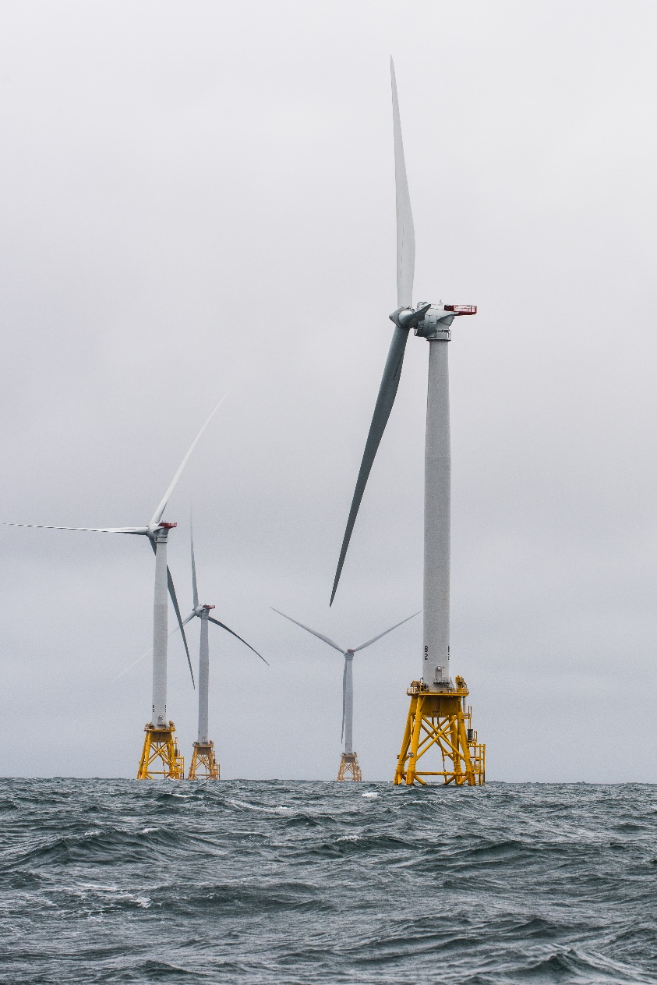
Workforce Development for Offshore Wind College of Liberal Arts and Center for African American Public Policy
Cassandra L. Newby-Alexander, Ph.D.
Timothy Goler, Ph.D.

Slide 2
Norfolk State University
WORKFORCE DEVELOPMENT FOR OFFSHORE WIND
FINAL REPORT
COLLEGE OF LIBERAL ARTS
CENTER FOR AFRICAN AMERICAN PUBLIC POLICY
Submitted to: Dominion Energy
PROJECT TEAM
CASSANDRA NEWBY-ALEXANDER
CHINEDU OKALA
TIMOTHY D. GOLER
ROBERT K. PERKINS
BENJAMIN ROGERS
AHMED WHITT

Slide 3
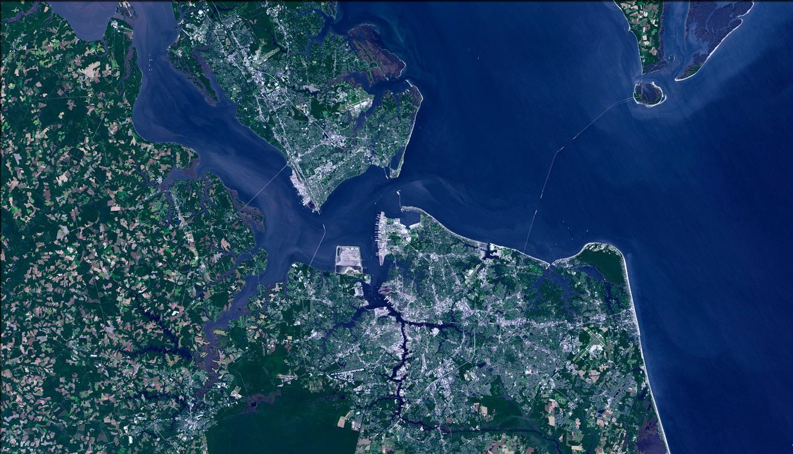
This report includes:
an assessment of the demographics of the Greater Hampton Roads specifically as it relates to African Americans
an assessment of the environmental burdens of urban life that includes neighborhoods marked by heavy industrial uses and vehicular and air travel
solutions to various issues identified that includes recommendations for:
building relationships and trust within the African American communities in Hampton Roads
Identifying potential partners that will work with Dominion Energy that include individuals and groups
identifying training resources and networking to foster community- driven research focused on enhancing social and environmental justice, and ensuring accessible locations for the community residents to utilize the services

Slide 4
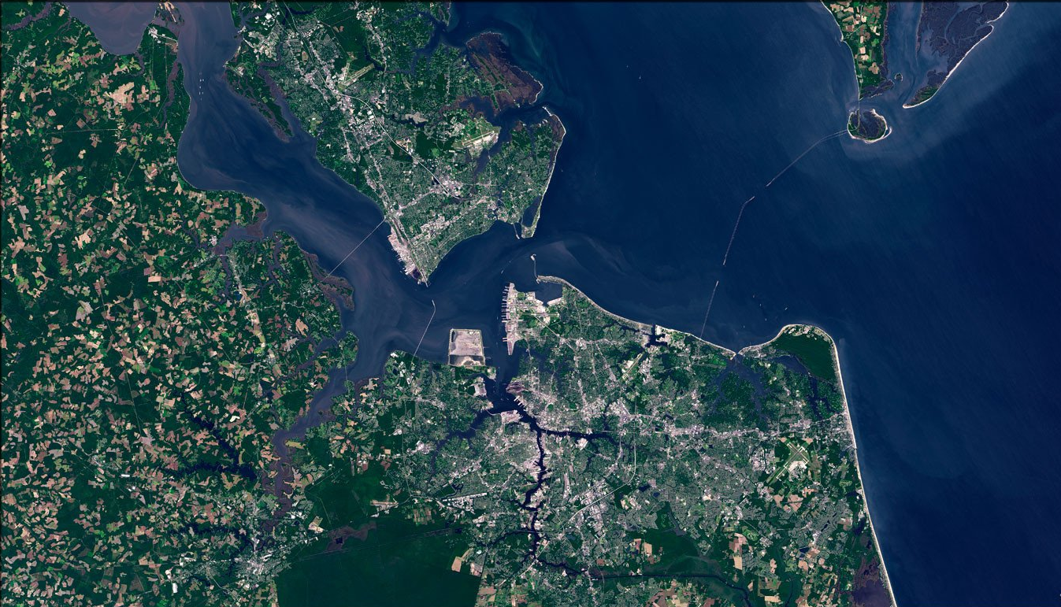
This report includes:
recommendations for distributing information that raises awareness among community members about the environment and health issues affecting their communities
suggestions for building a sustainable pipeline of students that are educated in the environmental factors that impact community health as a way to increase interest in Urban Affairs (environmental sustainability) and STEM (Science, Technology, Engineering, and Mathematics)
advice about developing a “fair” distribution of environmental benefits and burdens plan

Slide 5
Employment: Opportunities and Challenges
The Greater Hampton Roads region can be a powerful source of workforce recruitment because of the varying options based on education, workforce experience, and age. Consequently, numerous employment opportunities exist in Hampton Roads, especially because 20% of the population is a college graduate.
The military influence on employment rates is sizable.
The area has a trained workforce (e.g., maritime managers, engineers with shipboard experience, experience working at sea)
Many former military personnel are frequently seeking new
Support for entrepreneurial development (although this support lags for African Americans)
However, underemployment exists for African Americans, despite job seeking options. The question is how Dominion Energy and other companies can reach this untapped and needed workforce.

Slide 6
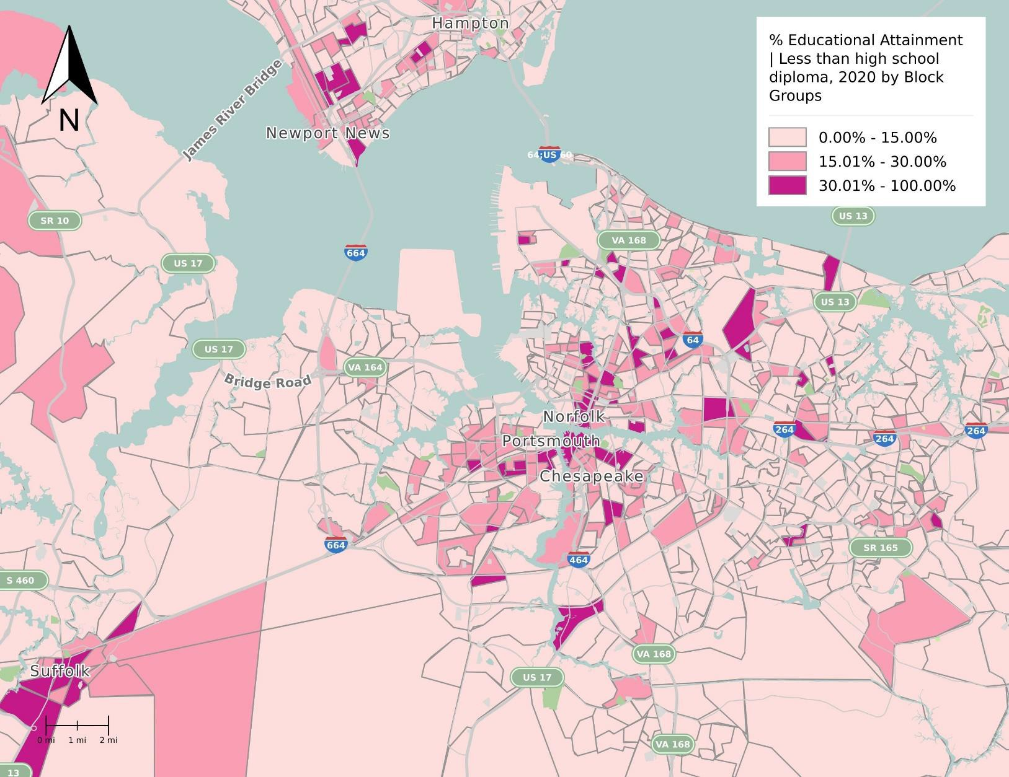

Slide 7
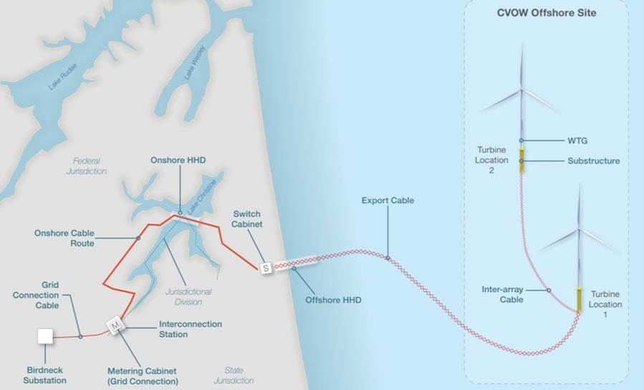
Environmental Impact: Opportunities and Challenges
The Greater Hampton Roads’ Black population disproportionately lives within areas with elevated airborne contaminants/pollutants. Households in high-risk areas are less likely to take advantage of energy-saving/clean energy opportunities.
There is a significant opportunity for Dominion Energy, the Legislature, and other stakeholders to perform targeted interventions.
City of Hampton: 19 brownfields and 9 Transmission Lines in Hampton (95-100% airborne contaminants heavily concentrated in and around Hampton University and the Veteran’s Administration campus)
City of Norfolk: 13 Transmission Lines and 4 Brownfields in Norfolk
City of Portsmouth: 20 Transmission Lines and 1 Brownfield
City of Newport News: 1 Brownfield
** Suffolk and the Williamsburg region do not have any Brownfield sites

Slide 8
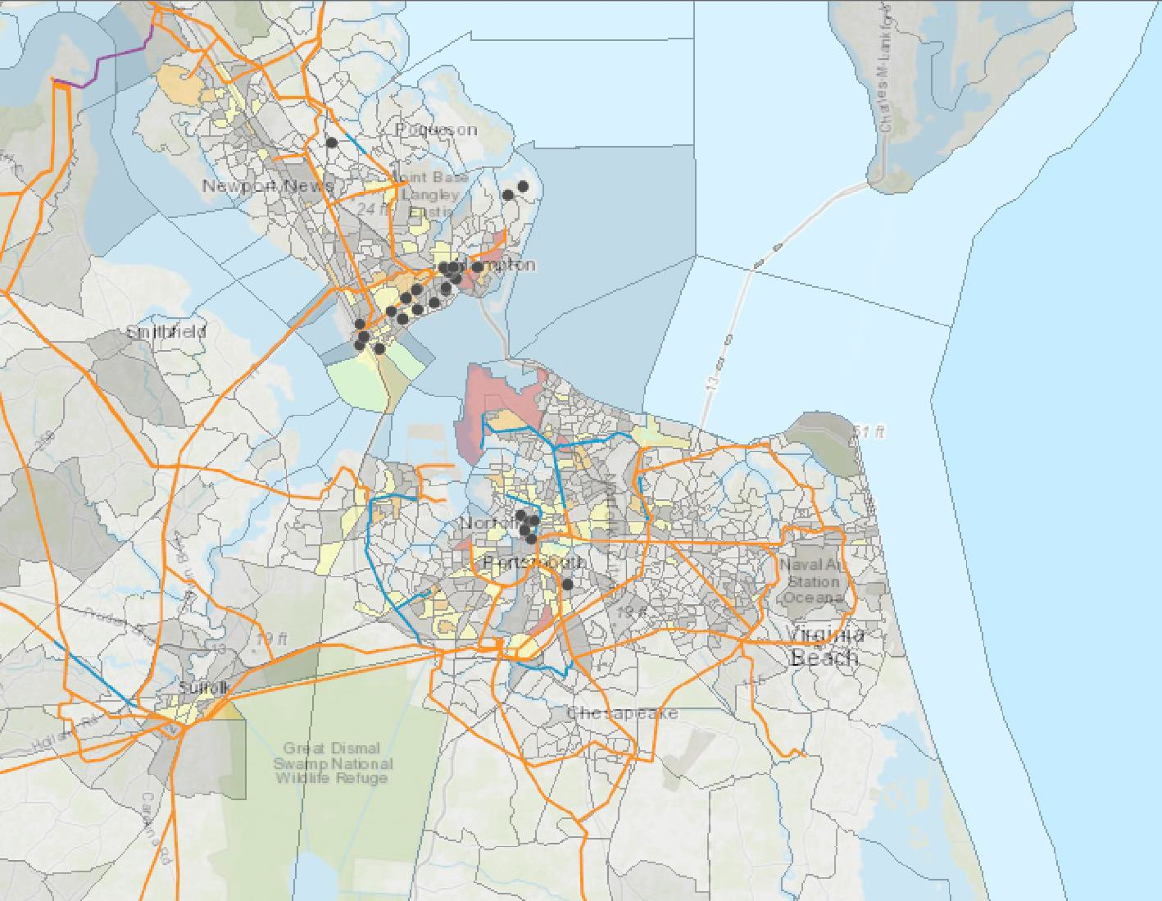
REGIONAL ENVIRONMENTAL THREATS
Throughout the region, the Black population disproportionately live within areas with elevate airborne contaminants (PM2.5 levels shown above). Also displayed: Dominion Energy Transmission Lines and brownfield property sites.
Data Sources:
ESRI, United States Environmental Protection Agency, United States Department of Agriculture, National Geospatial-Intelligence Agency, United States Geological Survey

Slide 9
Environmental Impact: Opportunities and Challenges
CORRELATION OF SOCIAL DETERMINANTS OF HEALTH DISPARITIES IN BLACK COMMUNITIES
Environmental pollutants disproportionately impact black communities throughout Greater Hampton Roads. Moreover, those same communities disproportionately are affected by health disparities.
Health challenges that disproportionately impact African Americans includes:
Prostate cancer
Breast cancer
Colon cancer
Hypertension
Diabetes
Overall shortened life expectancy

Slide 10
Information and Prospect Gap: Challenges and Opportunities
Lack of Access to the Internet
It is increasingly difficult for individuals without reliable high-speed internet access to connect to employment, skills training, adult education, and other development opportunities. In a household without computers and/or the internet, access to libraries and other institutions is crucial.
Educational Attainment and Workforce Development Opportunities
In Greater Hampton Roads, the average White household income is $81,660 while the average Black household income is $50,730. In addition, only 48% of African Americans own their homes compared to 73% for Whites. In many localities, this disparity is greater.
Therefore, reaching the untapped workforce and helping to prepare the population with the educational training needed requires a different approach.

Slide 11
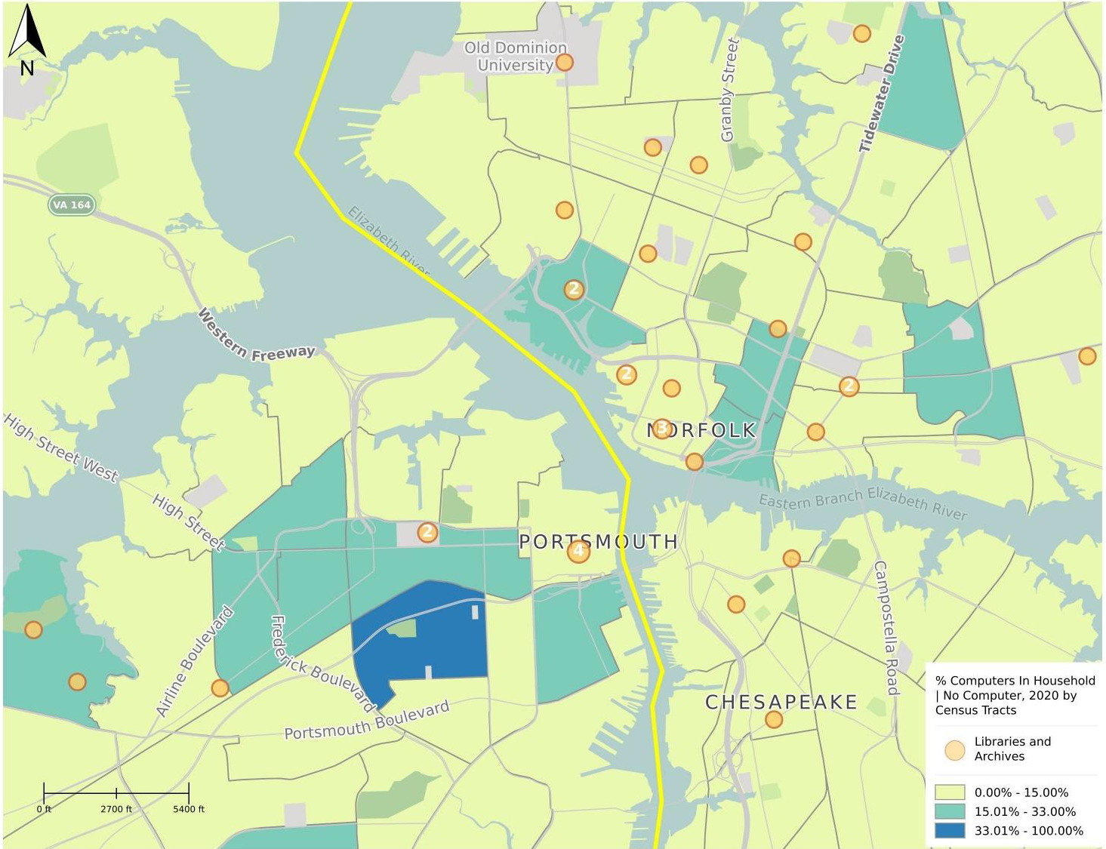
GAPS IN WEB ACCESS
It is increasing difficult for individuals without reliable high-speed internet access to connect to employment, skills training, adult education, and other development opportunities. In household without computers and/or internet, access to libraries and other institutions is crucial
Data Sources: United States Office of Management and Budget, United States Census Bureau [American Community Survey]

Slide 12
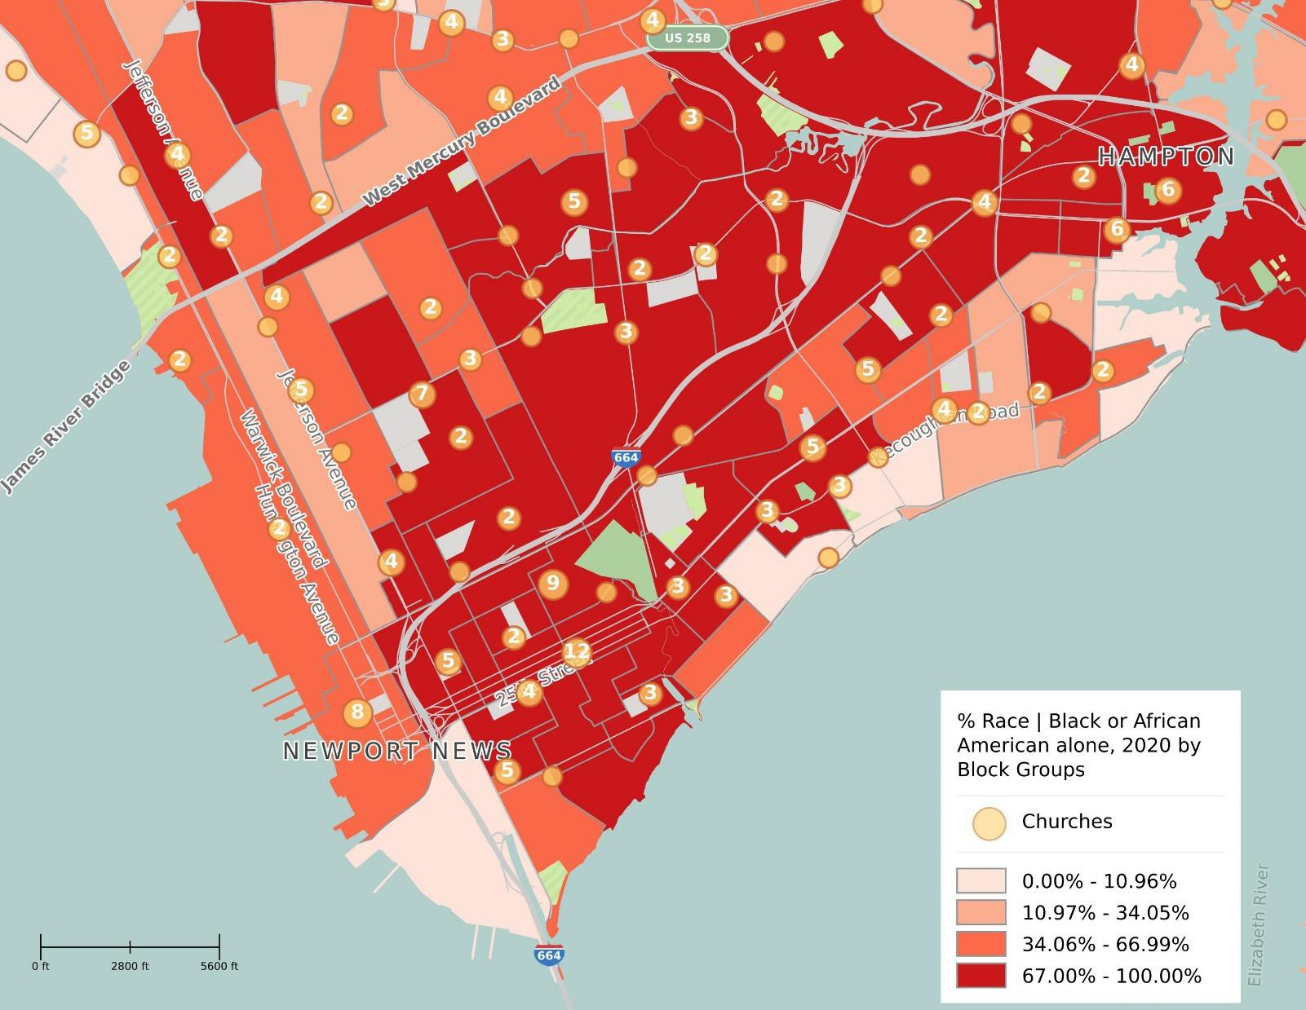
TARGET INSTITUTIONS TO FACILITATE OUTREACH & CAPACITY BUILDING
Understanding the population and resource distributions of the African- American community in the region, along with the relative proximity to risk factors, is necessary in the planning process.
Data Sources: United States Office of Management and Budget, United States Census Bureau

Slide 13
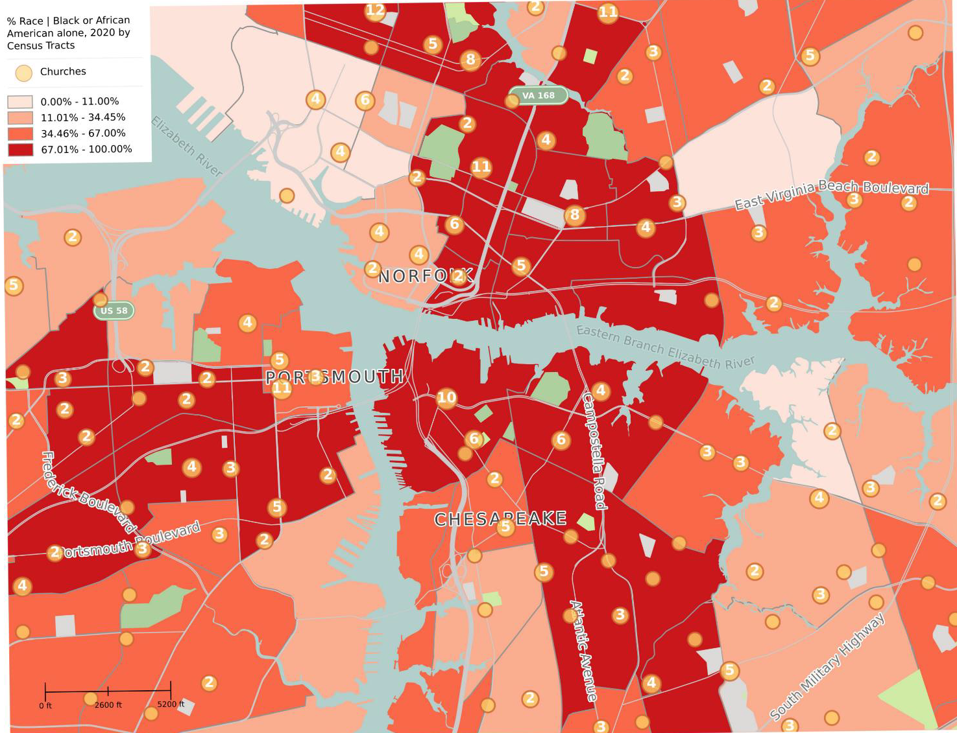
Understanding the population and resource distributions of the African- American community in the region, along with the relative proximity to risk factors, is necessary in the planning process.
Data Sources: United States Office of Management and Budget, United States Census Bureau
CHURCH LOCATIONS RELATIVE TO BLACK POPULATION CONCENTRATION

Slide 14
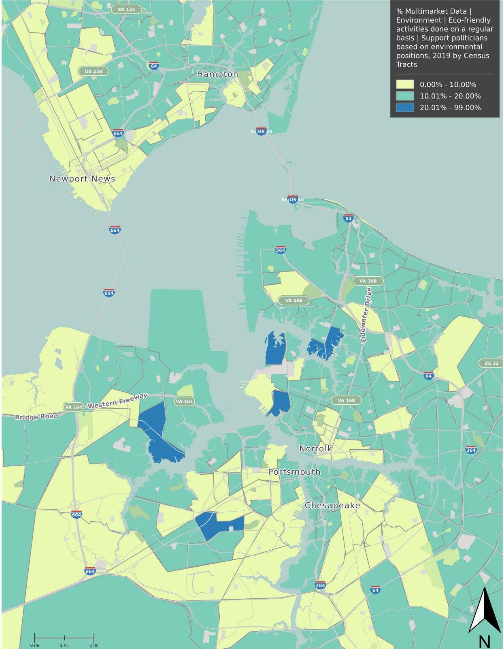
TARGET AREAS FOR OUTREACH
Households in high-risk areas are less likely to take advantage of energy-saving/clean energy opportunities. There is a significant opportunity for Dominion Energy, the Legislature and other stakeholders to perform targeted interventions.
Data: Scarborough (Nielsen Research)

Slide 15
Recommendations

Slide 16
Tracey Woods, vice president of operations of the American Association of Blacks in Energy (AABE) who argued that “the ideal workforce of the future is diverse.”
Ros Davison with the Windpower Monthly magazine argued that women, White, Black, Latina, Asian, etc. “bring different experiences to problem-solving and building relationships.” One of those important differences is the tendency of women to be more collaborative.

Slide 17
Opportunities
Environmental Educational Engagement with African American Communities
Training the Workforce of Tomorrow
Academic Alignment: Target
K-12 schools
Historically Black Colleges and Universities (HBCUs)
Occupational Certified Training
Workforce Development Centers
Offer Internships
Offer Scholarships
Entrepreneurial Opportunities

Slide 18
Opportunities
Grant Opportunities
Environmental Workforce Development and Job Training grant
Cleanup grants
Community and Institutional Organizations

Slide 19
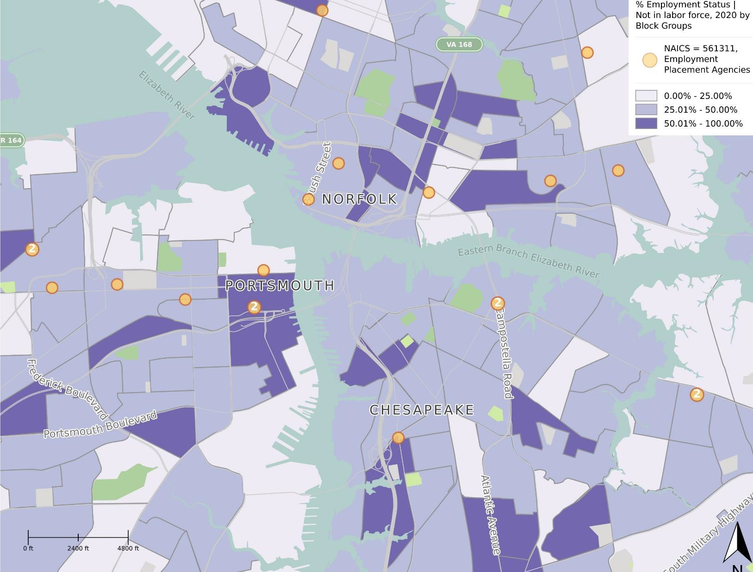
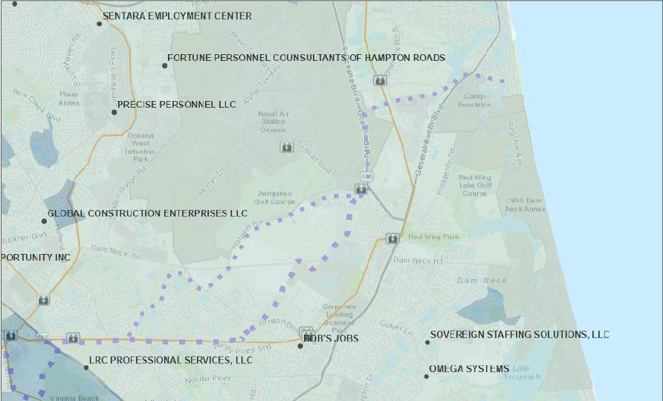
TARGET INSTITUTIONS TO FACILITATE EMPLOYMENT OPPORTUNITIES
In addition to civic institutions, placement agencies can serve as key intermediaries to connect individuals to new employment opportunities. The distribution of such agencies relative to labor market participation is highlighted above; specific agencies in the Offshore Wind Study Area are displayed right.

