Slide 1
LEVEL II / VASCUPP
What Does It Mean?
Ruby Spicer, Procurement Director
March 9, 2023

Slide 2
Questions

Slide 3
How To Do
Business With NSU
Erika Allen, Procurement Assistant Director
March 9, 2023

Slide 4
Introduction
LIASION
BEST VALUE
COMPLIANCE
Notes:
Procurement Services is the liaison between suppliers and all University Departments
Goals of Procurement Services to provide goods and services at the proper quantity, quality at the lowest possible cost
All procurement activities must follow applicable University, federal, state and local laws
The purpose of this presentation is to assist and inform vendors doing business with University a clear understanding of procurement policies

Slide 5
Mission
The mission of Procurement Services is to support the University Department/Activities through the procurement of high-quality goods, printing, and services at a reasonable price and in a manner that is fair, open and impartial to Contractors desiring to do business with the University.
Procurement Services, which includes the Central Warehouse, is also responsible for contract administration, contract compliance and evaluation, receiving, shipping, central stores and the acquisition and disposal of state and federal surplus property.

Slide 6
Fundamental Purchasing Principles
The fundamental principles for competitive procurement are set out in section §2.2-4300 of the Virginia Public Procurement Act, Code of Virginia, 1950 as amended, which promotes that:
All procurement procedures are conducted fairly and impartially, with avoidance of any impropriety or the appearance of impropriety;
All qualified vendors have access to public business;
No offer is arbitrarily or capriciously excluded;
Competition be sought to the maximum feasible degree;
Procurement procedures involve openness and administrative efficiency;
Rules governing contract awards be made clear in advance of the competition;
Specifications reflect the procurement needs of the agency rather than being drawn to favor a particular vendor; and
The University and vendors freely exchange information concerning what is sought to be procured and what.

Slide 7
Procurement Services Team
Support Staff
Geral Collins
Libbie Hudson
Contract Officers
Ersalyn Arrington
Roi Ewell
Senior Contract Officers
Michelle Purkett
Kacey Smith

Slide 8
Bidders and Offerors
Maintain current eVA profile.
Maintain updated Cardinal account.
Notify SBSD and eVA/DGS when status changes.
Must remain active in eVA as self-registered vendor.
Formal solicitations over $200,000 posted on eVA.
Notes:
The Commonwealth mandates that Norfolk State University, a state agency, conduct its procurement transactions utilizing the eVA system. All University suppliers are required to register with eVA before a contract award can be made with your company.
It is the responsibility of each vendor to keep their business profile current both in eVA as well as with the State’s financial system Cardinal through the Department of Accounts (DOA) when changes occur such as; the products or services offered, address, ownership, or status as a bidder or offeror. Vendors are also encouraged to notify representatives of the Department of Small Business Supplier Diversity when status changes as well as the Department of General Services, Electronic Virginia (eVA) team. Vendors must remain active in eVA as a self-registered vendor when doing business with state entities.

Slide 9
Procurement Methods
Most common procurement methods
Small Purchase
Quick Quote
Unsealed IFB and RFP
Competitive Sealed Bidding
Invitation for Bids (IFB)
Competitive Sealed Negotiation
Request for Proposals (RFP)
Notes:
- Small purchase procedures are used for the procurement for goods and services less than $100,000;
- Competitive sealed bidding is a formal process, used for the procurement of goods or services with a dollar value of $100,001.00 or more. [State Code §2.2-4301) Formal sealed bids/proposals are solicited using a written Invitation for Bid or sealed Request for Proposal.

Slide 10
Formal Solicitations
Invitation for Bids (IFB)
Error in Bid
Price Based; lowest responsive and responsible bidder
Request for Proposals
Best proposal selected based on criteria
Professional
Accounting, actuarial, architecture, land surveying, landscape architecture, law, medicine, optometry, pharmacy or professional engineering
Non-Professional
Notes:
Preferred method is competitive sealed bidding
A responsive bidder is defined as one who has submitted a bid which conforms in all material respects to the Invitation to Bid. A responsible bidder is defined as one who has the capability, in all respects, to perform fully the contract requirements, and the moral and business integrity and reliability which will ensure good-faith performance. (The University reserves the right to award bids based on the overall low total or the split low total, whichever is in the best interest of the University.)
Vendors are encouraged to review the Commonwealth of Virginia's Vendor Manual developed by the Department of General Services' Division of Purchases and Supply online at www.eva.state.va.us/learn-about-eva/vendors-manual.htm
If an error is detected before the bid closing date or the proposal opening date, the vendor may retrieve the bid or proposal from Procurement Services. Proper identification showing proof of employment will be required. The error may be corrected by drawing a single line through the mistake, making the correction, and initialing it in ink.
Competitive Negotiation for Professional services and nonprofessional services: Contracts will be awarded to the Offeror that has presented the best proposal. Offers will be selected for negotiations based on the evaluation factors specified in the Request for Proposal.

Slide 11
Cooperative Procurement
Cooperative and Joint Procurement
Cooperative Procurement: Usually one public body is lead and other public bodies can purchase from the contract.
Joint Procurement: All authorized parties can participate in jointly purchasing from the contract. No other public bodies can purchase from the contracts as joint purchasers.
VASCUPP, VHEPC, State & Federal (GSA) contracts, and national cooperatives (Sourcewell, Omnia Partners, etc.)
Notes:
A procurement by a public body with one or more other public bodies, for the purpose of combining requirements for the purchase of like goods and/or services in order to increase efficiency and/or reduce administrative expenses. Usually one public body is lead and other public bodies can purchase from the contract.

Slide 12
Post Award
Contract
Contract Administrator Designation
Purchase Order
Authority to provide goods or services
FOIA
Virginia Freedom of Information Act (§2.1-340, et. seq).
Notes:
Successful vendors are notified by receipt of a signed purchase order or by any other contractual agreement indicating an award
Understand and know what is in your contract, well written solicitation will make contract administration more smoother
Vendors are not to perform work without a purchase order, may cause delay in payment or no payment at all
State Code §2.2-4342 states that all proceedings, records, contracts, and other public records relating to procurement transactions will be open to inspection by any interested person, firm or corporation in accordance with the Virginia Freedom of Information Act (§2.1-340, et. seq).

Slide 13
Bonding Requirements
Bid Bond
Performance Bond
Contract Bond
Payment Bond
Fidelity Bond
Notes:
Bid Bond
Bidder forfeits bid bond by not accepting award
Performance Bond
Guarantees Contractor will perform contract
Contract Bond
Similar to performance bond, Used for services contract such as computer purchases, grass-cutting, janitorial services etc.
▪ A Fidelity Bond is similar to an insurance policy and guarantees against losses that may result from proven acts of dishonesty on the part of the contractor's employees who will handle cases or are exposed to opportunities for theft.
Payment Bond
Guarantees Contractor will pay all suppliers and subcontractors

Slide 14
SWaM Participation
It is the University's policy to contribute to the establishment, preservation, and strengthening of small, woman and minority owned businesses (SWaM) and to encourage their participation in State Procurement activities as per Executive Order 35.

Slide 15
Questions

Slide 16
2023 eVA Update
Vicki Lewis Beckett
eVA & Procurement Systems Analyst
March 9, 2023

Slide 17
Where Have We Been?
During 2019, Commonwealth of Virginia initiated solicitation to update Ariba e-procurement system.
Contract ultimately awarded and transition to new platform, Ivalua, began.
2020-2021: Announcements and virtual initiatives to introduce the New eVA.
Virginia Institute of Procurement Learning Management System (LMS) Self-paced learning journeys
‘Train the Trainer’ sessions
November 2022: New eVA Launch

Slide 18
Where Are We Headed?
Training & Transition
Meeting sessions and virtual training held throughout 2022
Weekly live and interactive training since February 2023
Focus:
Training on Requisition Input
Change Orders
Receiving Orders
eVA Go Live
Soft rollout to three to four departments
Campus-wide utilization at start of FY24
Targe Start: mid to late March 2023

Slide 19
Questions

Slide 20
Q &A with NSU Contract Officers
Tasha Jordan, Procurement Manager
Michelle Purkett, Senior Contracts Officer
Ersalyn Arrington, Contracts Officer
March 9, 2023

Slide 21
Small Purchase Procedures
Up to $10,000
Award to Micro (1st priority if price is reasonable)
Award to Small (2nd priority if price is reasonable)
Open to all (last priority)
Written documentation required if not awarding to
a micro business
Written documentation of quote(s) required
https ://www.nsu.edu/procurement/forms

Slide 22
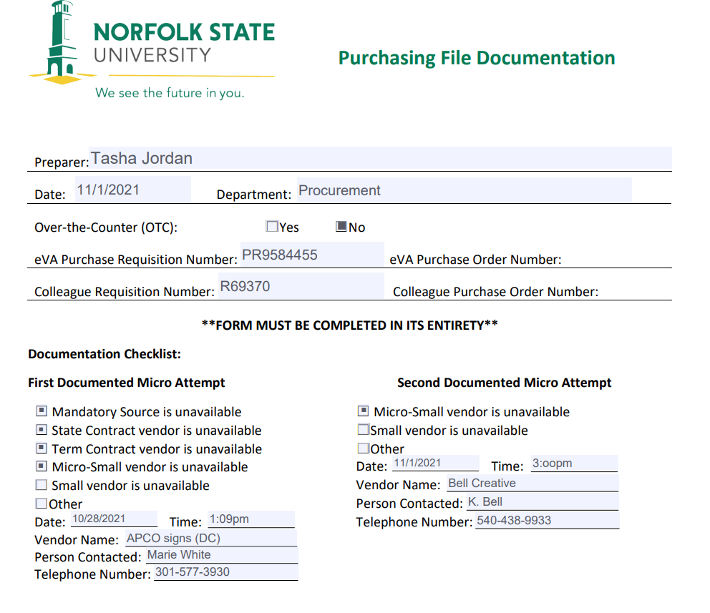

Slide 23
Sole Source
*Only One (1) Source Practicably Available*
Written determination required explaining:
Why only one product/services meet needs
Why only one contractor can provide
Why price is considered reasonable
Efforts made to get the best price
https://www.nsu.edu/procurement/forms

Slide 24
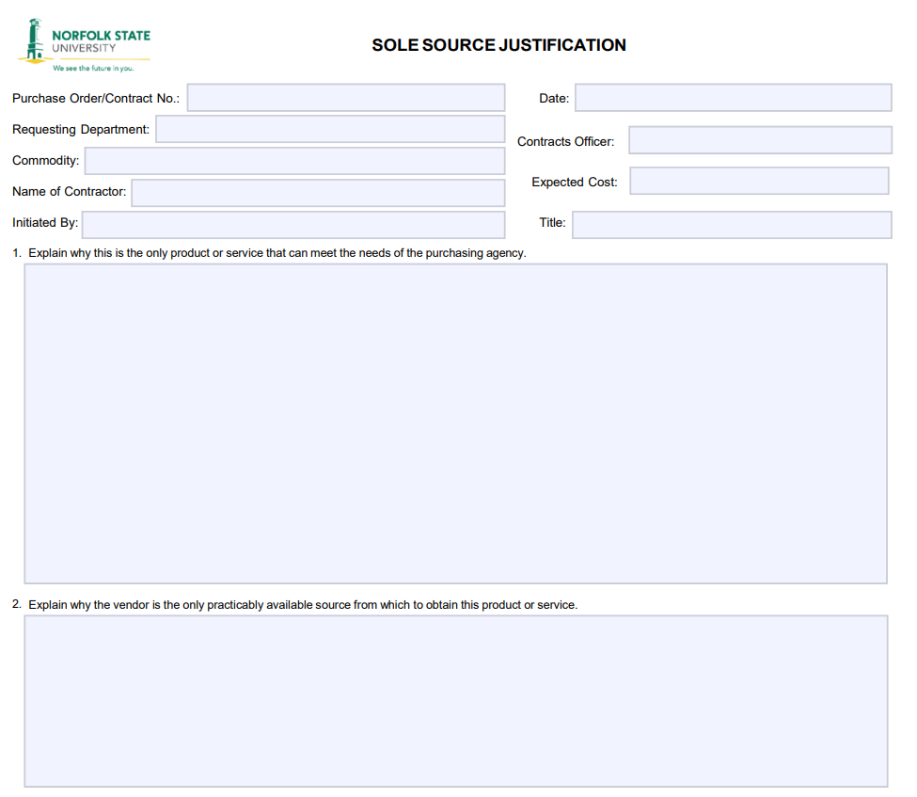

Slide 25
Emergency
Occurrence of a serious and urgent nature that
demands immediate action for the protection of
personal safety or property.
Assess the nature of the emergency.
Document the selection.
Award the contract.
https://www.nsu.edu/procurement/forms

Slide 26
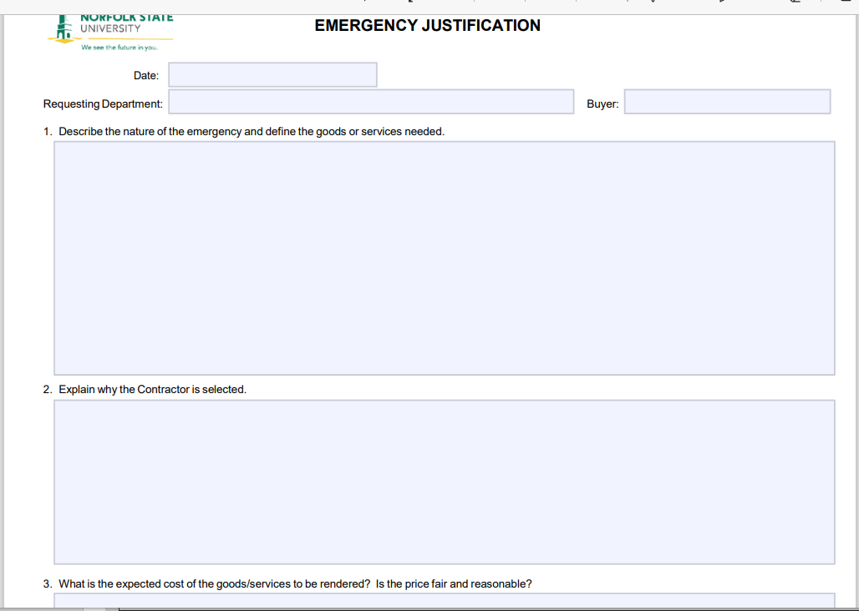

Slide 28
CONTACT:
Procurement Services @ 757-823-8053

