Slide 1
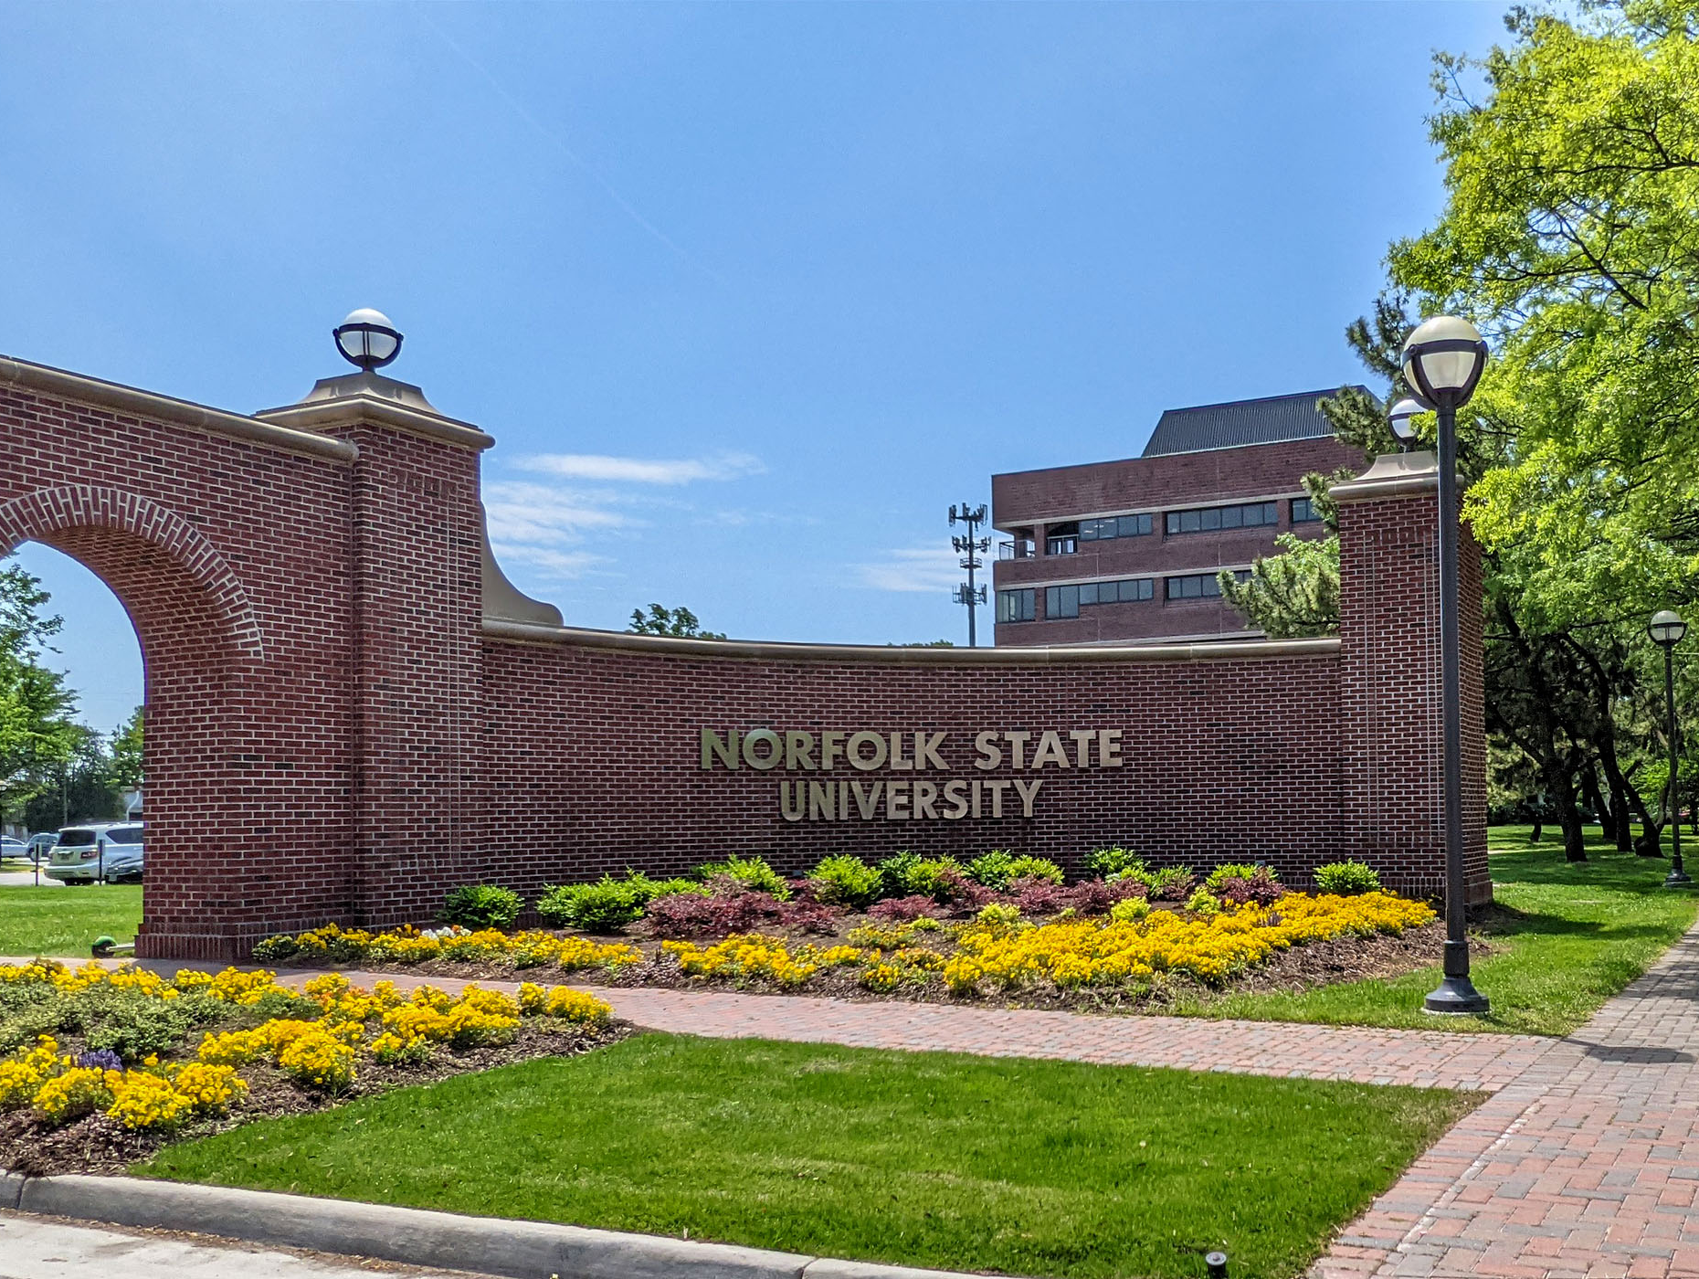
Norfolk State University
Faculty Senate
BOV Meeting
President: Robert K. Perkins, PhD
March 7, 2025

Slide 2
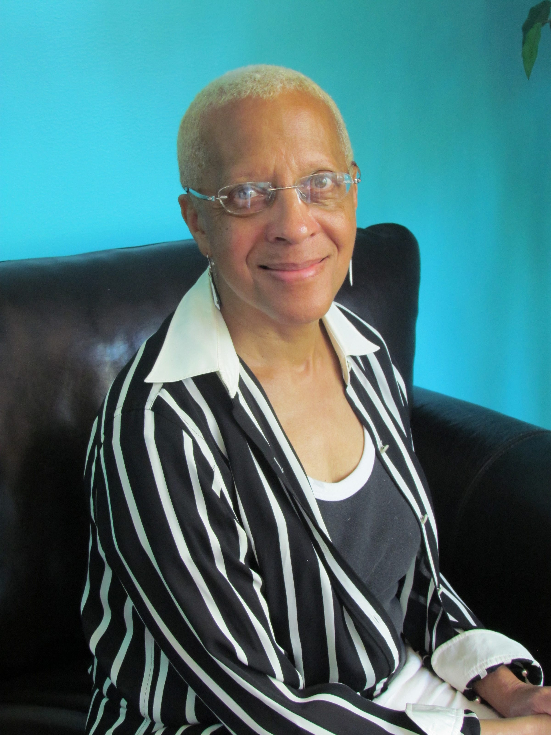
NSU Faculty Senate Salutes: Professor Carol Pretlow
Tenured Professor in the Political Science Department
Alumnus of NSU (Mass Communications)
Law Professor and Constitutional Expert
Advocate for traditional Pedagogy and Learning Styles
She was an independent fashion consult, independent talk show host for WAVY-TV and WRAP Radio 85; and was a commentator of WHRO’S Another View
Loved by generations of students and alumni
Staple in the community for social justice issues
Friend to the NSU Faculty Senate

Slide 3
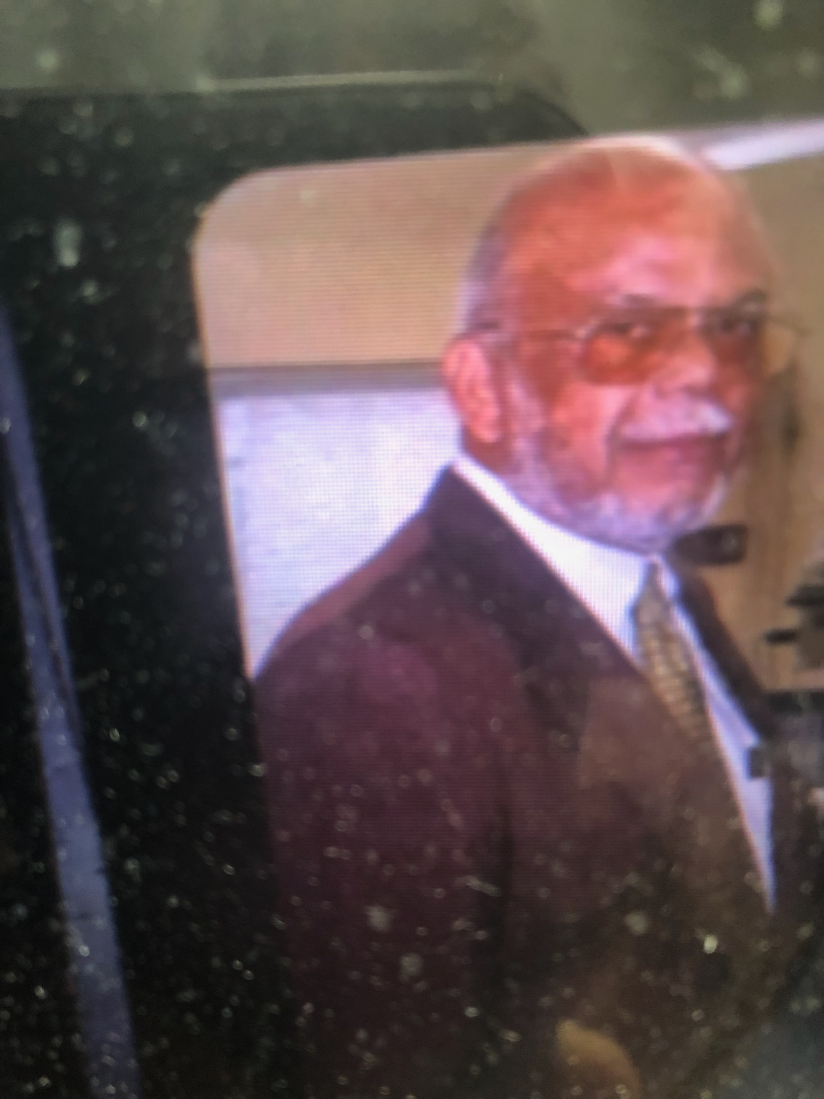
NSU Faculty Senate Salutes: Professor Milton Ferguson, Sr.
Tenured Professor of Physics in the Physics Department
Alumnus of NSU
He served 60+ years as a faculty member at NSU, making him the longest-serving professor in the history of NSU
Devoted husband, father of four and grandfather of seven
He served as a valuable mentor to many junior faculty members
He was known as pure gentleman on campus
NSU Faculty Senator at the time of his death

Slide 4
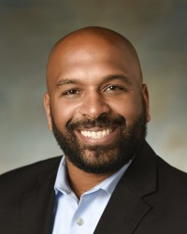
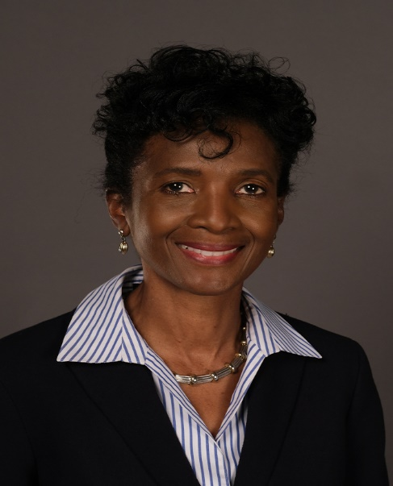
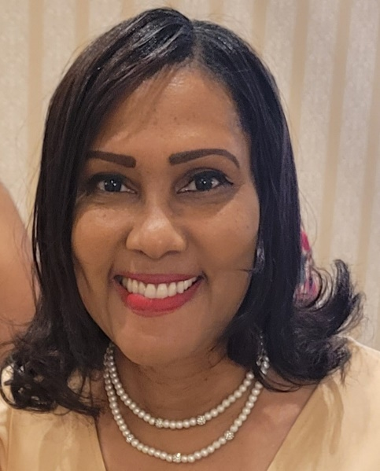
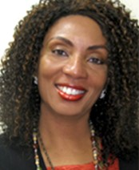
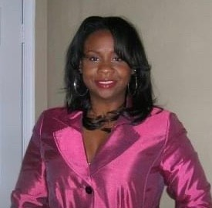
2024-2025 Faculty Senate Elected Officers
Dr. Robert K. Perkins
COLA
President
Dr. Shaun Anderson
SOED
Vice President
Dr. Charles Ford
COLA
Secretary
Dr. Audrey Douglas-Cooke
CSET
Assistant Secretary
Dr. John Kamiru
BUS
Treasurer
Dr. Colita Fairfax
SWK
State Representative
Dr. Sandra Williamson-Ashe
SWK
Executive Council
Dr. Felisa Smith
CSET
Executive Council

Slide 5
2024-2025 Faculty Senate Executive Committee
• Constitution and Bylaws Cathy Jackson (COLA)
• Elections and Nominations Michael Parker (CSET)
• Faculty Evaluation Policies and Procedures Cynthia Burwell (EDU)
• Faculty Handbook Revision Cassandra Newby-Alexander (COLA)
• Faculty Status and Welfare Batrina Martin (CSET)
• Grievance Advisory Colita Fairfax (SWK)
• Graduate School Representative Timothy Goler (COLA)

Slide 6
2024-2025 Faculty Senators

Slide 7
2024-2025 Strategic Plan
Actualizing and Emphasizing Shared Governance
"Shared governance" in higher education refers to structures and processes through which faculty, professional staff, administration, governing boards and, sometimes, students and staff participate in the development of policies and in decision-making that affect the institution.
It brings stakeholders together around passion for the institution and ensures the inclusion of a range of voices and ideas in the formulation of goals, priorities, and strategies.
Examining and Incorporating Artificial Intelligence in the Learning Experience
Assessment: The rise of AI will inspire the revision and rethinking of teaching and assessment methods. Faculty can use AI platforms to diversify student assessments, including formative, normative, and ipsative evaluations.
Critical Thinking: Using AI as a complementary tool may improve students’ learning process while challenging their critical thinking abilities.
Adaptability: There is an urgent need to prepare the future users, designers, and shapers of these technologies to keep up with the pace of change. An essential part of teaching students to use AI is to introduce them to new platforms and functionalities as these innovations arise.

Slide 8
2024-2025 Strategic Plan
Increase Faculty Unity across Disciplines
Faculty Unity is needed to focus on having a unified voice for advocacy of mutual issues, collaborative efforts, and mutual support.
The FS Executive Committee had planned different strategies, activities and support initiatives but we are uncertain if they can happen since our budget proposal was unilaterally denied.
Plans for these strategic initiatives may alter depending on University support.

Slide 9
Current Critical Issues
Sabbatical Report Response
Academic Calendar Issues
Faculty Emeritus Selection Process
Sabbatical Application
Student violence at Brambleton Center (Culture of Care?)
Town hall meeting with the President regarding national impact on NSU
Carrying on elections for the upcoming year
Accounts Payable issues (reimbursements)

Slide 10
Semester Accomplishments
Assisted in correcting serious University calendar issues
Created a AI Academic Committee Ad Hoc
Led by Dr. Claude Turner, Computer Scientist
Representative from each college are members
Assisted in developing the newly adopted General Education Curriculum
Reactivated our membership with the State Faculty Senate
Led by Dr. Colita Fairfax
Three Senators attended the training in Richmond on January 10th

Slide 11
Semester Accomplishments (cont.)
Partnering with Student Affairs for an initiative to increase the retention and graduation rates and inclusivity of black male students on campus.
Working with Allied Health to bring the 2024 National Society of Allied Health (NSAH) to NSU
Reestablished our membership with the American Association of University Professors (AAUP)
Led by Dr. Batrina Martin (President)
Plan to be reinstated by the date of the regional conference

Slide 12
Faculty Spotlight: Dr. Sheila A. Ward
Tenured Professor in the Department of Health, Physical Education and Exercise Science
Project Director of the NSU Health and Wellness Initiative for Women
Newly Named Trauma-Informed Healing-Centered Approaches Program Evaluator for the Virginia Department of Health
Collects and interprets complex evaluation data related to the effectiveness of the Trauma Informed Healing Centered Approaches (TIHCA) Program on Biomedical and Quality of Life indicators and funded agencies advancement along Trauma Informed metrics. Work with TIC staff and various external partners.

