Slide 1
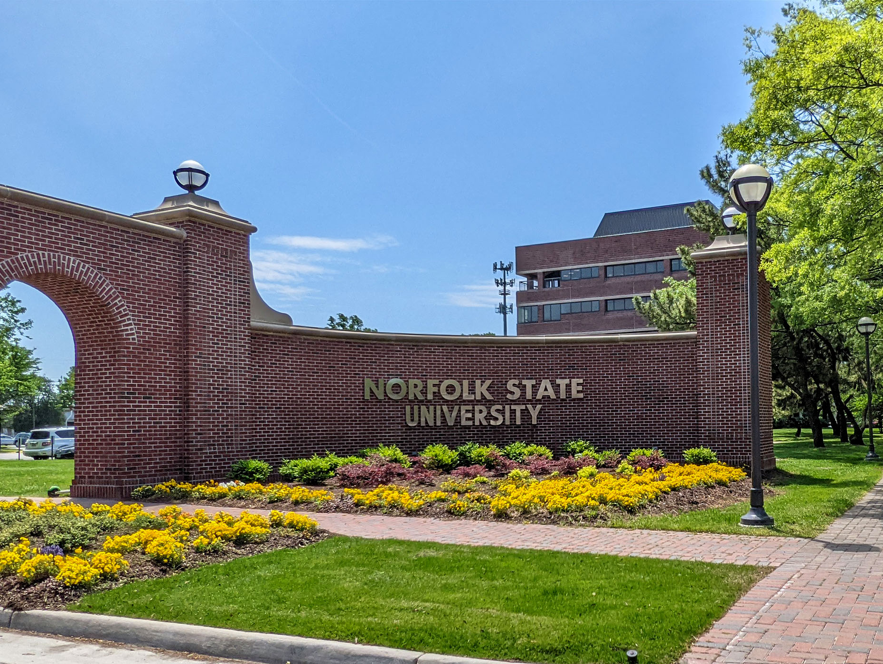
Norfolk State University
Faculty Senate
End-of-the-Year Report and BOV Report
President: Robert K. Perkins, PhD
April 30, 2025

Slide 2
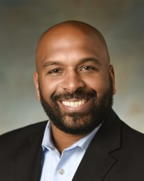
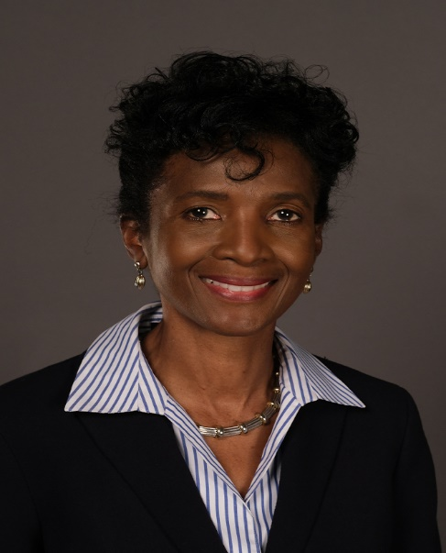
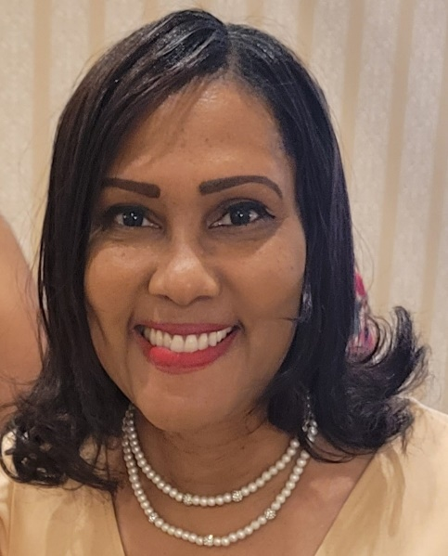
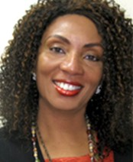
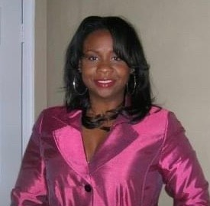
2023-2024 Faculty Senate Elected Officers
Dr. Robert K. Perkins
COLA
President
Dr. Shaun Anderson
SOED
Vice President
Dr. Charles Ford
COLA
Secretary
Dr. Audrey Douglas-Cooke
CSET
Assistant Secretary
Dr. John Kamiru
BUS
Treasurer
Dr. Colita Fairfax
SWK
State Representative
Dr. Sandra Williamson-Ashe
SWK
Executive Council
Dr. Felisa Smith
CSET
Executive Council

Slide 3
2023-2024 Faculty Senate Executive Committee
• Constitution and Bylaws Thomas Lewis (BUS)
• Elections and Nominations Michael Parker (CSET)
• Faculty Evaluation Policies and Procedures Cynthia Burwell (EDU)
• Faculty Handbook Revision Cassandra Newby-Alexander (COLA)
• Faculty Status and Welfare Batrina Martin (CSET)
• Grievance Advisory Colita Fairfax (SWK)
• Graduate School Representative Timothy Goler (COLA)

Slide 4
2023-2024 Faculty Senators

Slide 5
2024-2025 Strategic Plan
Actualizing and Emphasizing Shared Governance
"Shared governance" in higher education refers to structures and processes through which faculty, professional staff, administration, governing boards and, sometimes, students and staff participate in the development of policies and in decision-making that affect the institution.
It brings stakeholders together around passion for the institution and ensures the inclusion of a range of voices and ideas in the formulation of goals, priorities, and strategies.
Examining and Incorporating Artificial Intelligence in the Learning Experience
Assessment: The rise of AI will inspire the revision and rethinking of teaching and assessment methods. Faculty can use AI platforms to diversify student assessments, including formative, normative, and ipsative evaluations.
Critical Thinking: Using AI as a complementary tool may improve students’ learning process while challenging their critical thinking abilities.
Adaptability: There is an urgent need to prepare the future users, designers, and shapers of these technologies to keep up with the pace of change. An essential part of teaching students to use AI is to introduce them to new platforms and functionalities as these innovations arise.

Slide 6
2024-2025 Strategic Plan
Increase Faculty Unity across Disciplines
Faculty Unity is needed to focus on having a unified voice for advocacy of mutual issues, collaborative efforts, and mutual support.
The FS Executive Committee had planned different strategies, activities and support initiatives but we are uncertain if they can happen since our budget proposal was unilaterally denied.
Plans for these strategic initiatives may alter depending on University support.

Slide 7
Other Accomplishments
Had 100% Departmental participation
Reestablished the American Association of University Professors (AAUP) membership (Dr. Batrina Martin)
Created the first ever NSU Faculty Senate AI Task Force (Dr. Claude Turner)
Strengthened and reinvigorated our relationship with the Virginia Faculty Senate
Finally secured an office space
Strengthened alliances across campus
Police Department
Library Services
Access and Equal Opportunity
Completed one faculty grievance
Initiated the faculty and staff town hall, with over 500 in attendance

Slide 8
Other Accomplishments (con’t)
Activated all the University Committees
Submitted Handbook Revisions
Held 2025 FS Elections, including Departmental Senate representation
Sabbatical Program approved, still waiting on the application approval
Worked with the Provost on serious issues with the Academic Calendar
Assisted in forming and participated on the reinvigorated Academic Calendar Committee
Continue to raise serious concerns regarding Accounts Payable about the travel reimbursement process and paying outside businesses for rendered services
Special Thank you to Ms. Derika Burgess for assisting us with this matter
Any many other accomplishments

Slide 9
The NSU Faculty Senate is strong, and the faculty is united!
The NSU Faculty Senate has been led with integrity, and we have ALWAYS governed by the policy set by the University, BOV, and the State of Virginia.
Faculty Senate website: https://www.nsu.edu/facultysenate

Slide 10
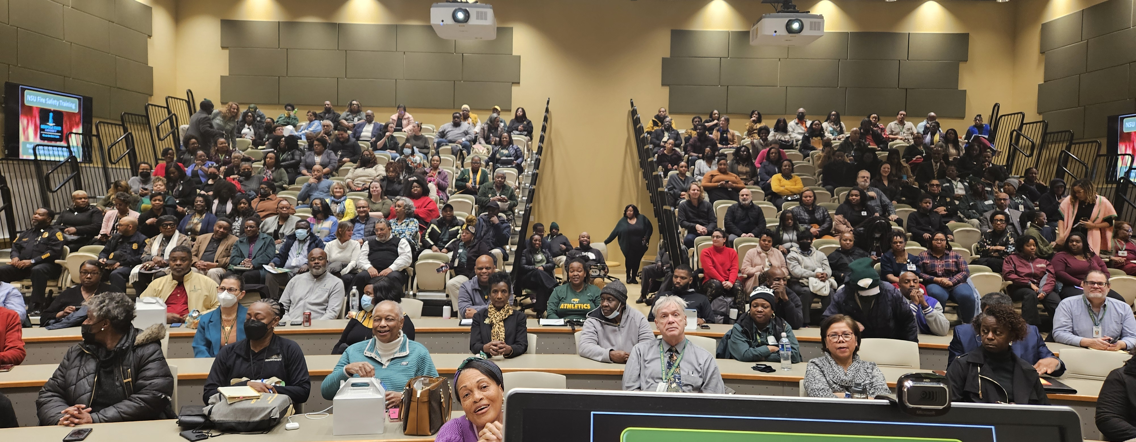
Thank YOU! On behalf of the NSU Faculty Senate, thank you for the continuous and attentive oversight of our University.

