Slide 1
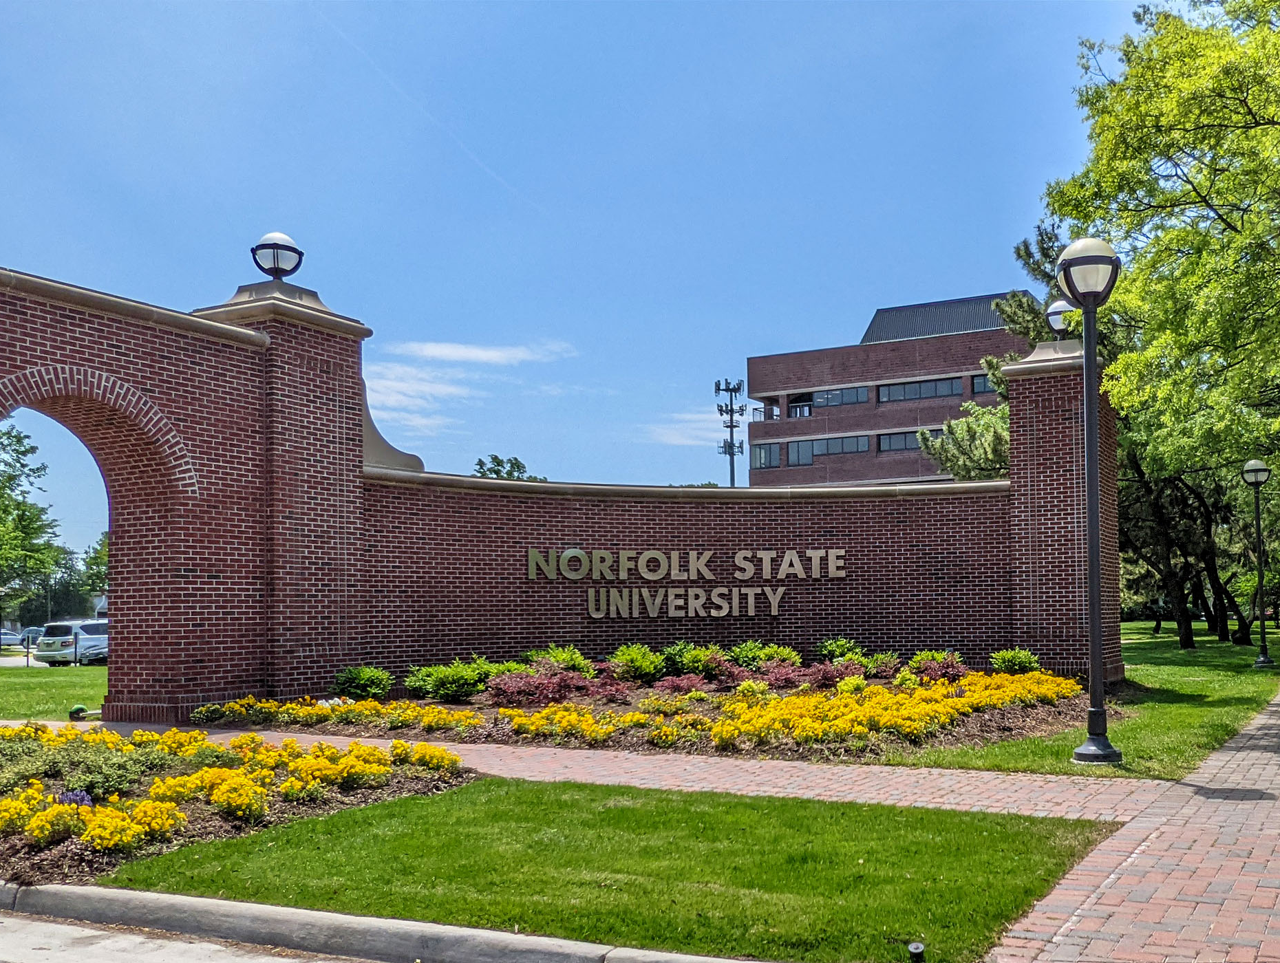
Norfolk State University
Faculty Senate
End-of-the-Year Report and BOV Report
President: Robert K. Perkins, PhD
April 16th, 2024

Slide 2
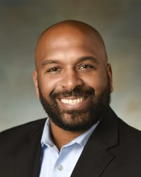
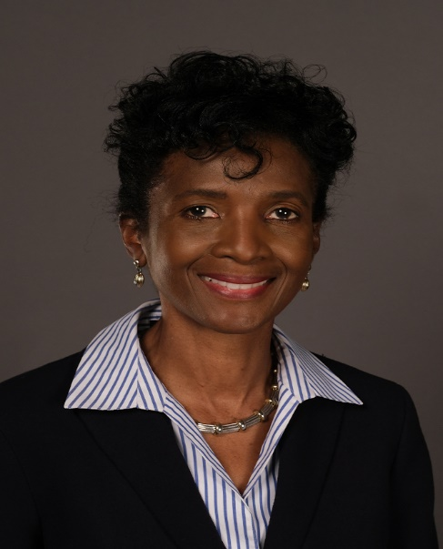
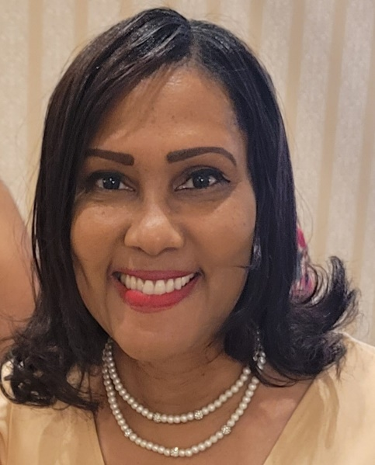
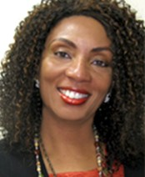
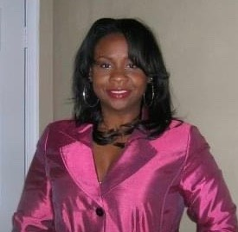
2023-2024 Faculty Senate Elected Officers
Dr. Robert K. Perkins
COLA
President
Dr. Shaun Anderson
SOED
Vice President
Dr. Charles Ford
COLA
Secretary
Dr. Audrey Douglas-Cooke
CSET
Assistant Secretary
Dr. John Kamiru
BUS
Treasurer
Dr. Colita Fairfax
SWK
State Representative
Dr. Sandra Williamson-Ashe
SWK
Executive Council
Dr. Felisa Smith
CSET
Executive Council

Slide 3
2023-2024 Faculty Senate Executive Committee
• Constitution and Bylaws Thomas Lewis (BUS)
• Elections and Nominations Michael Parker (CSET)
• Faculty Evaluation Policies and Procedures Cynthia Burwell (EDU)
• Faculty Handbook Revision Cassandra Newby-Alexander (COLA)
• Faculty Status and Welfare Batrina Martin (CSET)
• Grievance Advisory Colita Fairfax (SWK)
• Graduate School Representative Timothy Goler (COLA)

Slide 4
2023-2024 Faculty Senators

Slide 5
Our Focus for 2023 Academic Year
Create and institute a Faculty Senate Strategic Plan
Mission Statement
Vision Statement
Objectives
Strategic Initiatives
Goals and Standards
Rebuild a long-lasting Faculty Senate infrastructure
Website
Office Suite
Administrative Staff
Budget (a real one)
Phone Number
Reinvigorate/Strengthen relationships and collaborations with entities across the University
Academic Affairs Leadership (Dr. Fulton)
Student Affairs (Dr. Brown)
Finance and Business (Dr. Hunter)
University Advancement (Mr. Porter)
Athletics (Ms. Webb)
Transparency and Accountability
We must hold leadership accountable
We must hold ourselves accountable
We will commit to being transparent, while holding the confidence of the University and faculty members
Ensure that faculty members are accountable professionally and ethically, not legally

Slide 6
1. Create and institute a Faculty Senate Strategic Plan
Mission Statement July 1, 2024
Vision Statement July 1, 2024
Objectives July 1, 2024
Strategic Initiatives July 1, 2024
Goals and Standards July 1, 2024

Slide 7
2. Rebuild a long-lasting Faculty Senate infrastructure
Website In process, release date June 17th
Office Suite Waiting on Administration to assign
Administrative Staff Ms. Felicia Barnes
Budget (a real one) Presented to President on April 15th
Phone Number (757) 823-2761

Slide 8
3. Reinvigorate/Strengthen relationships and collaborations with entities across the University
Academic Affairs Leadership (Drs. Fulton and Perkins)
Created a Faculty Workload Committee
Established University’s Open Educational Resource Committee
Addressed and collaborated for better course first day activation, syllabus quiz, and pre-loaded Blackboard shells
Reexamining the fifth-week grading process
Met with tenured-track and term faculty regarding their experiences
Updated University Committees
Sabbatical Task Force Report (waiting on approval or suggestions)
Commencement Marshall Selection

Slide 9
Student Affairs (Drs. Brown and Martin)
Communication Via Email Between SA and Faculty
Improving Student Graduation, Retention, Wellness, and Mental Health
NSU Inaugural Black Male Symposium
Student Behavior at Ceremonies
Increasing Faculty Involvement
Participation in two Admitted Student Day events
Increased involvement with advising student organizations
Finance and Business (Drs. Hunter and Anderson)
Addressed issues with faculty not being paid on time for grants and course overloads
Addressed issues with delayed reimbursements (now getting them in 30 days)
Faculty now receiving travel reimbursement paperwork

Slide 10
University Advancement (Mr. Porter and Dr. Ford)
Collaborating with UA on a Taste Ghana
Panel for Opening Session for Faculty network for funding
Operations/Chief Strategists for Institutional Effectiveness (Dr. Moses)
Off-campus help desk issues (back on campus)
Technology issues are increasingly worsening, FS has brought this to the attention of administration several times
HR-1 processes being condensed with lines of approval and now is electronic
Athletics (Ms. Webb and Dr. Douglas-Cooke)
Student advising
Delineating between Athletic Advisors and Academic Advisors
Student Athletes Block Scheduling
Support for Coach Jones and the male Basketball team
Faculty Recognition at basketball game

Slide 11
4. Transparency and Accountability
We must hold leadership accountable
We have!
We must hold ourselves accountable
We have!
We will commit to being transparent, while holding the confidence of the University and faculty members
We have!
Ensure that faculty members are accountable professionally and ethically, not legally
We have!

Slide 12
Other Accomplishments
Had 100% Departmental participation
Held the first Faculty Senate Inauguration Ceremony
Completed two faculty grievances
Organized and assisted in planning the mass casualty training with over 300 participants
Assisted in sponsoring the 2023 NAACP Freedom Fund Banquet
Partnered with Black History Program in the Ndaba Mandela program
Activated all the University Committees
Submitted Handbook Revisions
Held 2024 FS Elections
Finalized the proposed FS 2024 Budget
Attestation Form has amended
Any many other accomplishments

Slide 13
The NSU Faculty Senate is strong!
The morale of the faculty is increasing, and their voices are being channeled dutifully via the NSU Faculty Senate.

