Slide 1
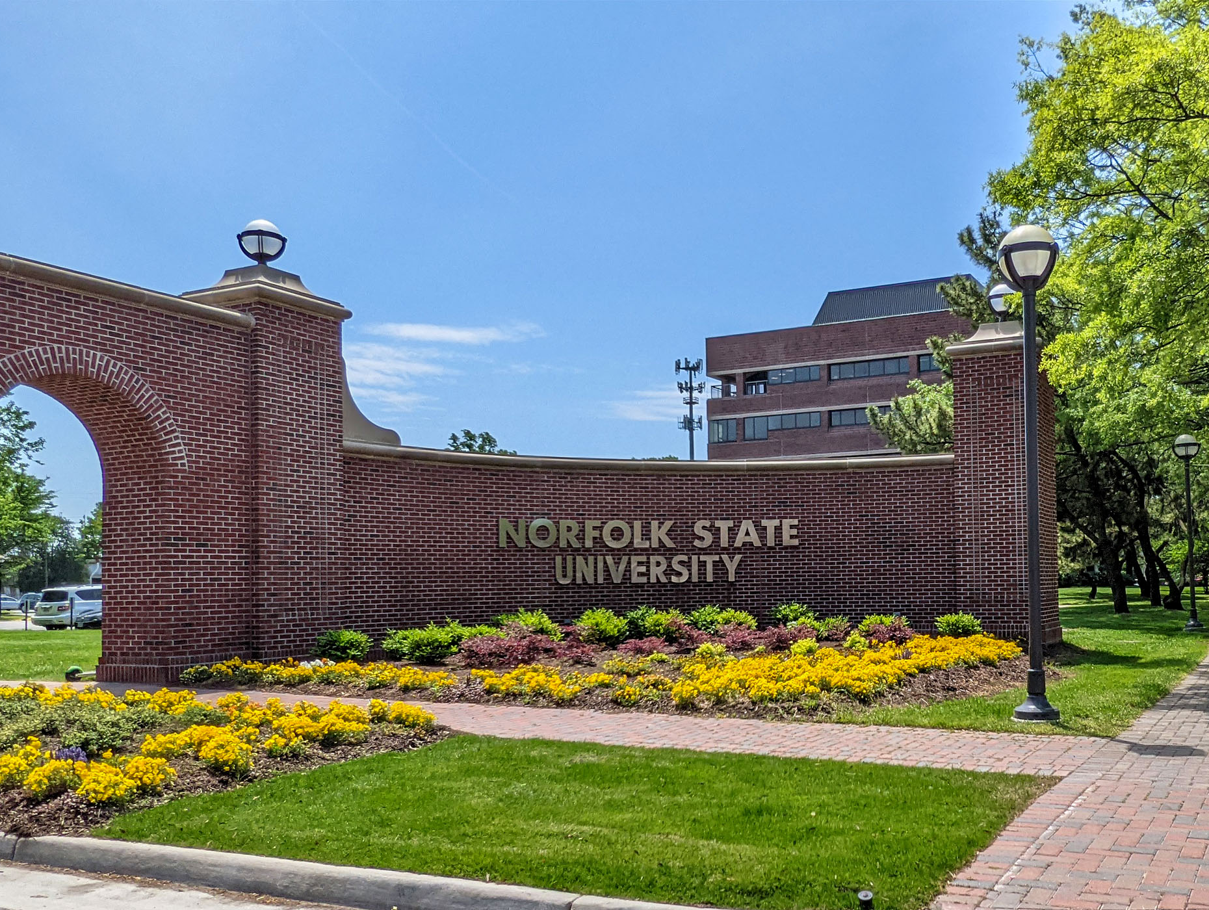
Norfolk State University
Faculty Senate
BOV March 2024 Report
President: Robert K. Perkins, PhD
March 8, 2024

Slide 2
Greetings!
The NSU Faculty Senate is strong!
The morale of the faculty is increasing, and their voices are being channeled dutifully via the NSU Faculty Senate.

Slide 3
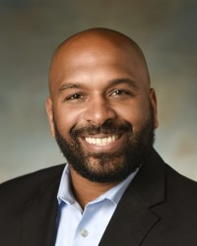
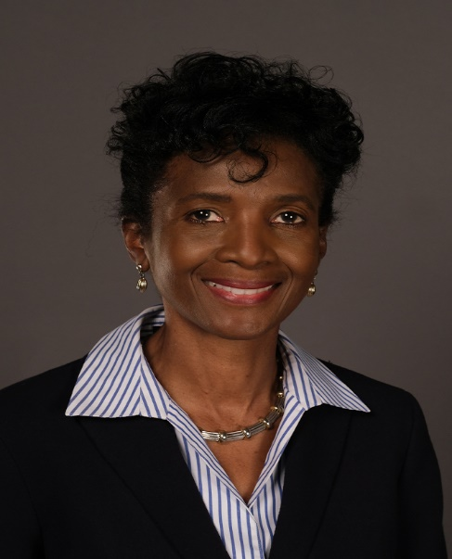
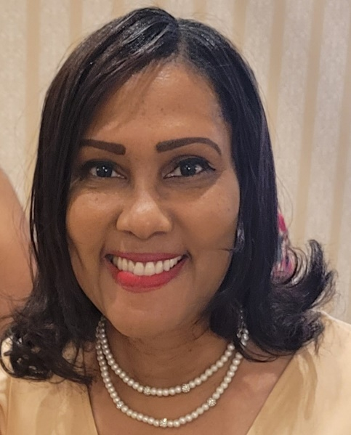
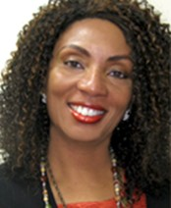
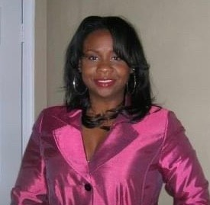
2023-2024 Faculty Senate Elected Officers
Dr. Robert K. Perkins
COLA
President
Dr. Shaun Anderson
SOED
Vice President
Dr. Charles Ford
COLA
Secretary
Dr. Audrey Douglas-Cooke
CSET
Assistant Secretary
Dr. John Kamiru
BUS
Treasurer
Dr. Colita Fairfax
SWK
State Representative
Dr. Sandra Williamson-Ashe
SWK
Executive Council
Dr. Felisa Smith
CSET
Executive Council

Slide 4
2023-2024 Faculty Senate Executive Committee
• Constitution and Bylaws Thomas Lewis (BUS)
• Elections and Nominations Michael Parker (CSET)
• Faculty Evaluation Policies and Procedures Cynthia Burwell (EDU)
• Faculty Handbook Revision Cassandra Newby-Alexander (COLA)
• Faculty Status and Welfare Batrina Martin (CSET)
• Grievance Advisory Colita Fairfax (SWK)
• Graduate School Representative Timothy Goler (COLA)

Slide 5
2023-2024 Faculty Senators

Slide 6
Our Focus for 2023 Academic Year
Create and institute a Faculty Senate Strategic Plan
Mission Statement
Vision Statement
Objectives
Strategic Initiatives
Goals and Standards
Rebuild a long-lasting Faculty Senate infrastructure
Website
Office Suite
Administrative Staff
Budget (a real one)
Phone Number
Reinvigorate/Strengthen relationships and collaborations with entities across the University
Academic Affairs Leadership (Dr. Fulton)
Student Affairs (Dr. Brown)
Finance and Business (Dr. Hunter)
University Advancement (Mr. Porter)
Athletics (Ms. Webb)
Transparency and Accountability
We must hold leadership accountable
We must hold ourselves accountable
We will commit to being transparent, while holding the confidence of the University and faculty members
Ensure that faculty members are accountable professionally and ethically, not legally

Slide 7
Critical and Outstanding Issues
Missed pay cycle (Faculty and Department Chairs are very concerned)
Embarrassment to the University
Adjunct instructors may not return
Faculty are already overwhelmed with teaching course overloads
Students are complaining that they cannot get the courses they need for their matriculation
Sabbatical Report (detailed 16-paged document in compliance with the handbook)
No response in nearly two years
Faculty Senate Office Space (former office was given to the Ombudsman)
We recently requested assistance from the President and Provost
Activating the University Committees
Has only partially been activated

Slide 8
Collaborating Wins
Completed the initial Mass Casualty Training
Over 300 participants
All sectors of the University attended
Travel reimbursements are now being completed within 30 days
HR-1 process for new faculty and graduate assistants are being expedited
Working well with Extended Learning to incorporate Blackboard Ultra
Which will be a friendlier system for faculty and students
New (shared) Administrative Assistant – Ms. Felecia Barnes
Work with HR to create a more comprehensive hiring system
Working with the President and Provost to address the concerns with the language in the Attestation Form.

Slide 9
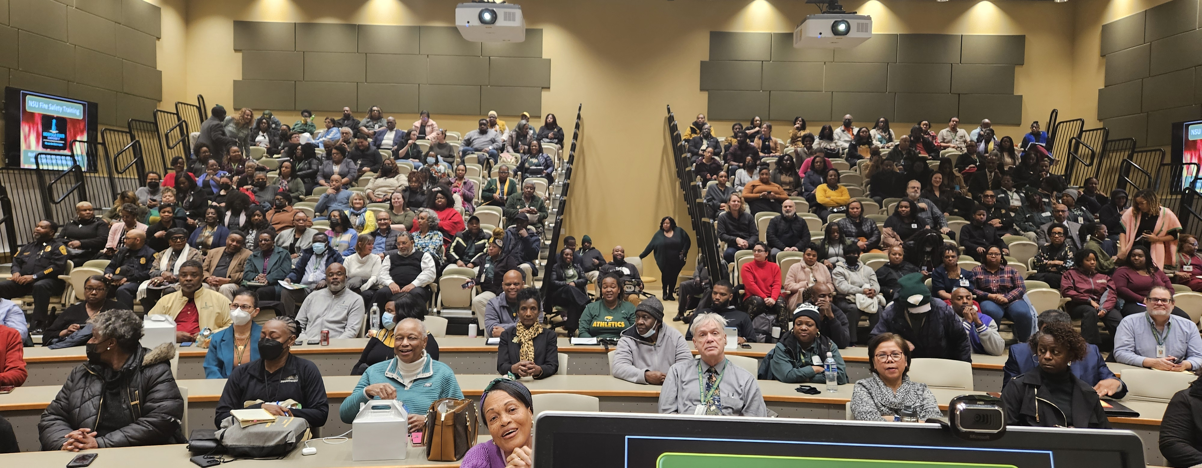
2024 NSU Mass Casualty Training

Slide 10
Completing Projects for Spring 2024
Finalizing a proposed Faculty Senate operating budget for the 2024 academic year (by April 30th)
Finalizing and recommending changes to the handbook (done)
Updating the Faculty Senate bylaws (done)
Finalize our strategic plan (by April 16th)
We are in the process of conducting elections for the 2024-26 academic years (by April 16th)

Slide 11
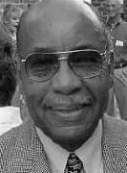
Faculty Highlight: Dr. Roderic A. Taylor
Dr. Taylor studied at Virginia State College, American University, Howard University, Catholic University, and Virginia Union University.
He began his professorial career over 60 years ago at NSU.
Dr. Taylor is a sculptor and the retired Chair of the Fine Arts Department.
With over 200 exhibits, he was selected by Dr. Samella Lewis as one of the top 75 black living artists in her book, Black Artists on Art.
Following his retirement from NSU, he was appointed by the governor to fill a vacancy on the board of the Virginia Commission for the Arts.
Currently, Dr. Taylor is an emeritus and adjunct professor of Fine Arts.
At the ripe age of 93, Dr. Taylor has been unanimously voted by the Faculty Senate to be the Mace Bearer for the May 2024 commencement ceremony.

Slide 12
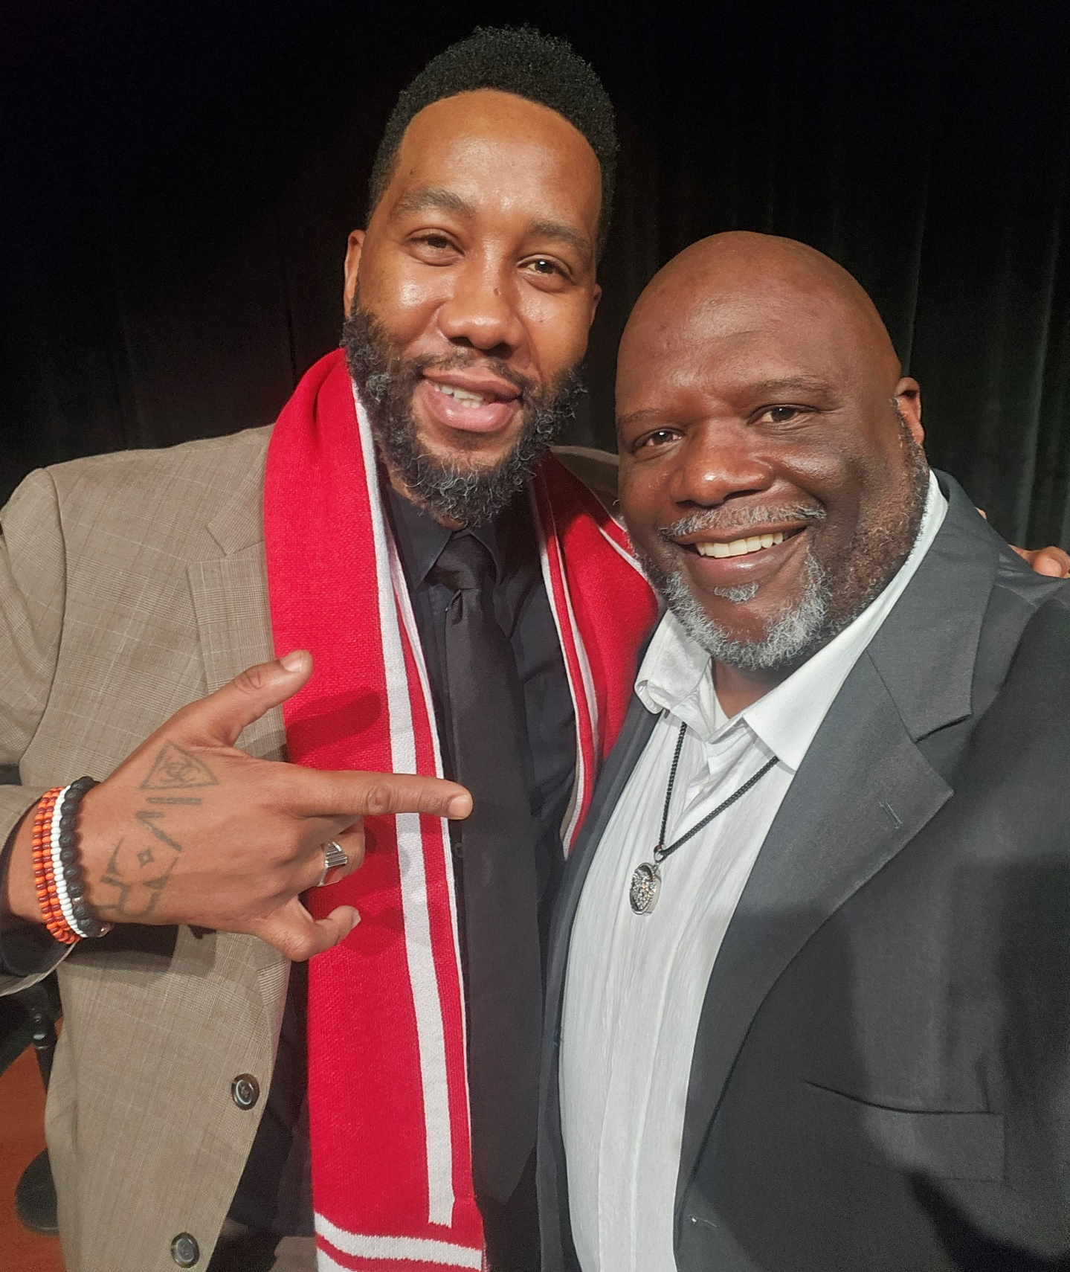
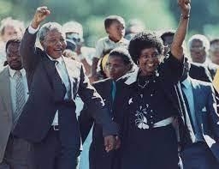
Thank YOU! On behalf of the NSU Faculty Senate, thank you for the continuous and attentive oversight of our University. NSU is still making dreams come true!!

Slide 13
The Senate have two questions for the BOV Consideration:
Is it possible to soften the language on the Attestation Form?
The academy has always held faculty ethically and professionally responsible for tenure and promotion but never legally responsible.
The faculty was not made aware of this form until after their service and they were mandated to sign or their colleagues’ tenure and promotion will be declined.
The faculty has serious concerns with the term “legally.”
Some faculty members have declined to serve on the tenure and promotion committees due to the risky legal exposure to themselves and their families.
Is it possible for the Faculty Senate reports to be included in the BOV booklet?

