Slide 1
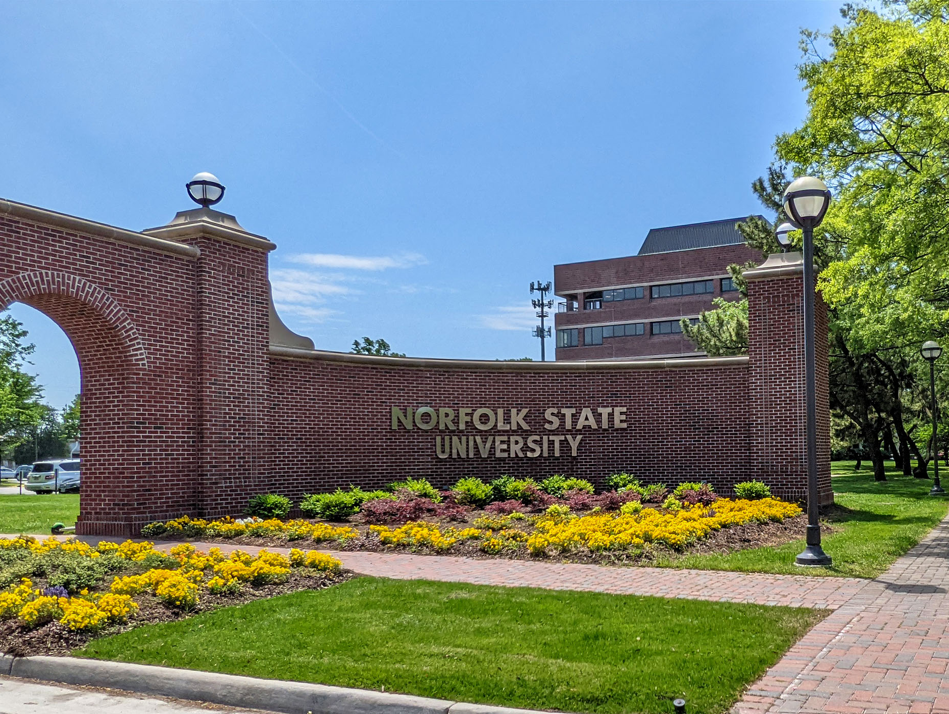
Norfolk State University
Faculty Senate
BOV December Report
President: Robert K. Perkins, PhD
December 8, 2023

Slide 2
Greetings!
The NSU Faculty Senate is strong!
For the first time, we have 100% participation from all
departmental elected Senators!
The morale of the faculty is increasing, and their voices are being channeled dutifully via the NSU Faculty Senate.

Slide 3
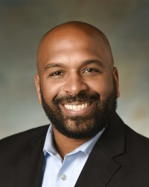
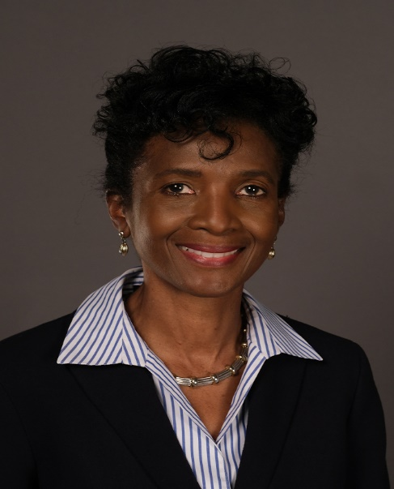
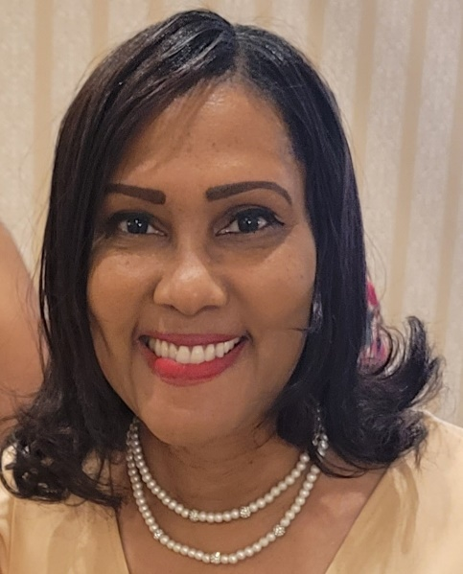
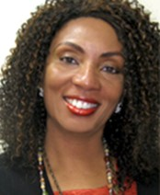
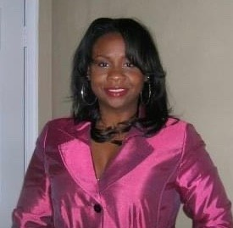
2023-2024 Faculty Senate Elected Officers
Dr. Robert K. Perkins
COLA
President
Dr. Shaun Anderson
SOED
Vice President
Dr. Charles Ford
COLA
Secretary
Dr. Audrey Douglas-Cooke
CSET
Assistant Secretary
Dr. John Kamiru
BUS
Treasurer
Dr. Colita Fairfax
SWK
State Representative
Dr. Sandra Williamson-Ashe
SWK
Executive Council
Dr. Felisa Smith
CSET
Executive Council

Slide 4
2023-2024 Faculty Senate Executive Committee
• Constitution and Bylaws Thomas Lewis (BUS)
• Elections and Nominations Michael Parker (CSET)
• Faculty Evaluation Policies and Procedures Cynthia Burwell (EDU)
• Faculty Handbook Revision Cassandra Newby-Alexander (COLA)
• Faculty Status and Welfare Batrina Martin (CSET)
• Grievance Advisory Colita Fairfax (SWK)
• Graduate School Representative Timothy Goler (COLA)

Slide 5
2023-2024 Faculty Senators

Slide 6
Our Focus for 2023 Academic Year
Create and institute a Faculty Senate Strategic Plan
Mission Statement
Vision Statement
Objectives
Strategic Initiatives
Goals and Standards
Rebuild a long-lasting Faculty Senate infrastructure
Website
Office Suite
Administrative Staff
Budget (a real one)
Phone Number
Reinvigorate/Strengthen relationships and collaborations with entities across the University
Academic Affairs Leadership (Dr. Fulton)
Student Affairs (Dr. Brown)
Finance and Business (Dr. Hunter)
University Advancement (Mr. Porter)
Athletics (Ms. Webb)
Transparency and Accountability
We must hold leadership accountable
We must hold ourselves accountable
We will commit to being transparent, while holding the confidence of the University and faculty members
Ensure that faculty members are accountable professionally and ethically, not legally

Slide 7
Critical and Outstanding Issues
Technological Issues
Dean Appointment Issues
Excessive Annual Evaluation Mandates (Tenure and Promotion Review Attestation)
Faculty Workload Report

Slide 8
Collaborating Progress
Security/emergency training
Severely delayed travel reimbursements
Excessively slow HR-1 process for faculty and graduate assistants
Overreach by Extended Learning into courses at the onset of the semester
Increasing faculty morale
Faculty Senate office space

Slide 9
Collaborating Wins
The Generalist Administrative Assistant will provide support to the Faculty Senate.
Participation in the NAACP Banquet, where the FS partnered for community wellness. Provost Fulton purchased a table, and many of the Deans attended, where four impressive students were recognized for their service and academics:
Malik Cunningham – BA in Mass Communication
Indya Richards – BA in Fashion Design
DeAndre Bradley – MA in Criminal Justice
Ashleigh Wilson – PhD in Materials Science
Dr. Brown in Student Affairs partnering with FS in the 2024 NSAH Conference focusing on social determinants of health (SOH) and the impact on social determinants of learning (SDL).
Mr. Porter in the NSU Foundation collaborated with FS to instill “giving back” in the culture of NSU for students from day one.
Ms. Webb in Athletics continues collaborating with the FS on strategies to best advise student-athletes, considering the added extra curriculum demands on athletes.

Slide 10
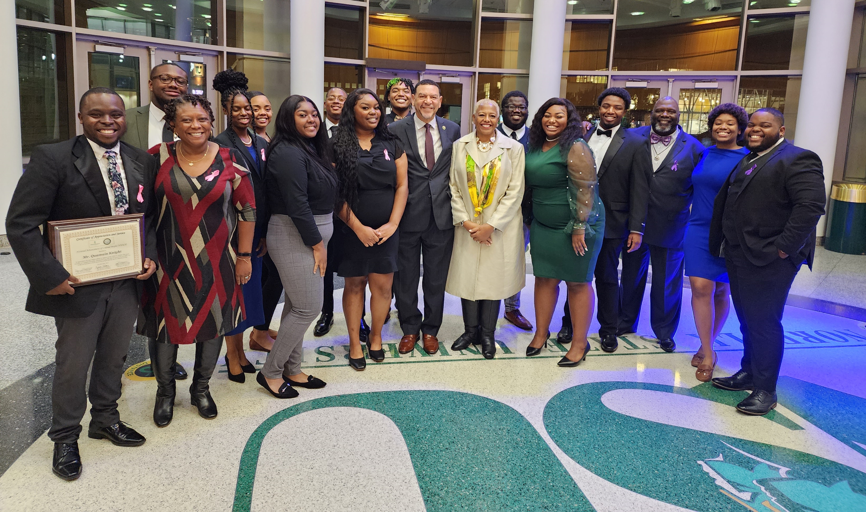
NAACP Freedom Fund Banquet 2022

Slide 11
Upcoming Projects for Spring 2024
Finalizing a proposed Faculty Senate operating budget for the 2024 academic year
Finalizing and recommending changes to the handbook
Updating the Faculty Senate bylaws
Work with HR to create a more comprehensive system
Finalize our strategic plan
Collaborate with the Awards Committee for an end-of-the-year awards ceremony
Continue to collaborate with Student Affairs for a city-wide inaugural Black male summit
We will also conduct elections for the 2024-25 academic year

Slide 12
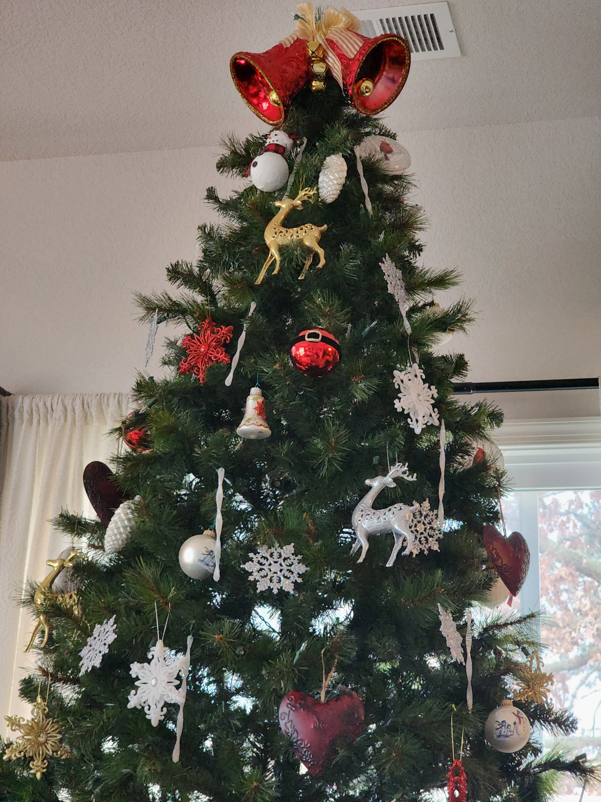
Thank YOU! On behalf of the NSU Faculty Senate, thank you for the continuous and attentive oversight of our University. Happy Holidays!!

