Slide 1
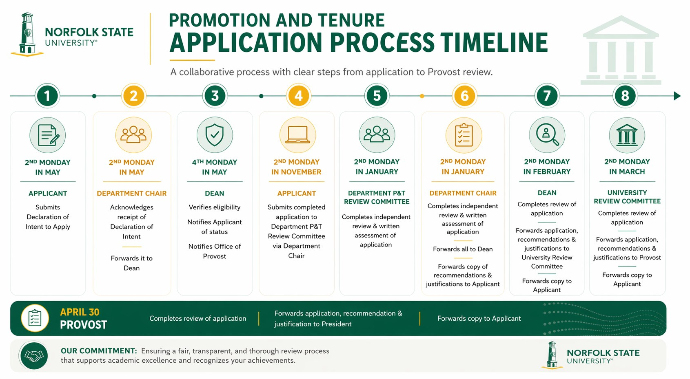
For more information on promotion and tenure application procedures, please refer to Section 3.5.3 Application Process for Promotion and Section 3.6.3 Application for Tenure Procedures of the Teaching Faculty Handbook.

