Slide 1
Storm Water Pollution Prevention Norfolk State University Facilities Management Keeping GREEN in the GREEN and the GOLD

Slide 2
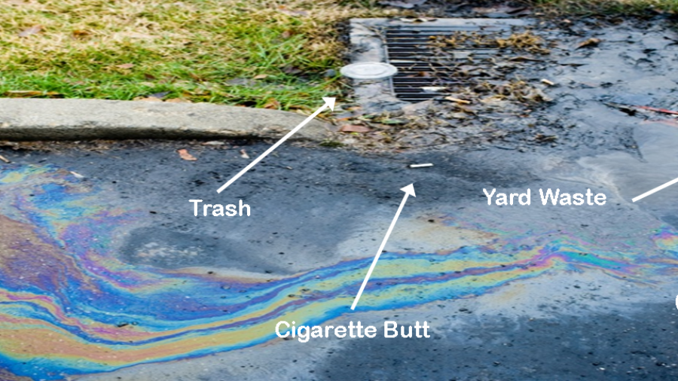
What is Storm Water?
Storm Water is runoff from rain and snowmelt. Storm water runoff picks up pollutants such as oil, grease, cigarette butts and chemicals which flows directly into streams and lakes unfiltered.

Slide 3
NSU Storm Water Route
At NSU, Storm water flows through underground piping directly to Elizabeth River and then to the Atlantic Ocean without any filtration or treatment

Slide 4
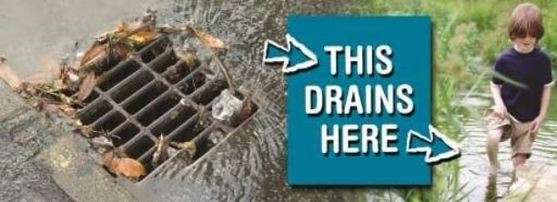
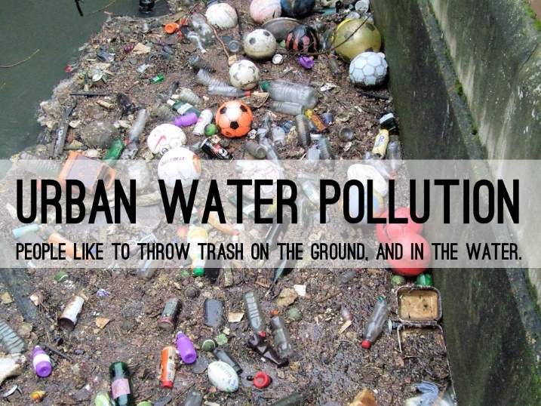
Storm Water Facts
Storm water discharges are often the #1 source of ocean, bay, lake, and river pollution in the U.S.
It is estimated that storm water contributes as much as 80 percent of the total water pollution in the U.S.
One quart of oil can contaminate 250,000 gallons of water.
One pint of motor oil can produce an oil slick one acre in size.

Slide 5
You Can Help!!!
Never litter! Keep outside areas trash free.
Do not perform repairs on personal vehicles! No use of antifreeze, fuels or lubricants on campus.
Prevent spills from entering storm drains.
Recycle paper, aluminum cans, food, grease, cleaning solutions, oil, antifreeze, batteries and fluids.
Clean up spills immediately (inside and outside) to minimize safety hazards and deter spreading.
Dispose of cigarette butts in designated areas.

Slide 6
You Can Help!!!
Practice good housekeeping inside and outside buildings.
Store rags properly to avoid contamination of storm water. Chemicals will flow into storm drain during a rain shower.
Use absorbents to clean liquid spills in outside areas.
Keep floors and impervious surfaces free of contaminants. Walk on sidewalks instead of lawns.
Join the revolution to restore the Elizabeth River. The Elizabeth River Project https://elizabethriver.org/
Adopt a Highway
https://www.virginiadot.org/programs/prog-aah-about-adoption.asp

Slide 7
THANK YOU, For Your Attention!
We Wish You Success in Your
Career Here At
Norfolk State University
“BEHOLD THE GREEN AND
GOLD!!!”

